Slide 1
Enabling Computational Journalism: Automated Fact-Checking and Story-Finding
Chengkai Li
Associate Professor, Department of Computer Science and Engineering
Director, Innovative Database and Information Systems Research (IDIR) Laboratory
University of Texas at Arlington
Shandong University, Oct. 9th, 2015
Nanjing University, Oct. 13th, 2015
©2015 The University of Texas at Arlington. All Rights Reserved.

Slide 2
The Innovative Database and Information Systems Research (IDIR) Laboratory
Research areas
Big Data and Data Science (Database, Data Mining, Web Data Management, Information Retrieval)
Theme of current research
building large-scale human-assisting and human-assisted data and information systems with high usability, low cost and applications for social good
Research directions
computational journalism
crowdsourcing and human computation
data exploration by ranking/skyline/preference queries
database testing
entity search and entity query
graph database usability
©2015 The University of Texas at Arlington. All Rights Reserved.

Slide 3
Our Computational Journalism Project
Started in 2010. Collaborative project with Duke, Google Research, and Stanford. Collaboration with HP Labs China and Chinese Academy of Sciences.
Story finding: finding and monitoring number-based facts pertinent to real-world events. The facts are leads to news stories.
Fact checking: discovering and checking factual claims in political discourses, social media, and news.
©2015 The University of Texas at Arlington. All Rights Reserved.

Slide 4
Publications
Detecting Check-worthy Factual Claims in Presidential Debates. Naeemul Hassan, Chengkai Li, Mark Tremayne. CIKM 2015, pages 1835-1838.
The Quest to Automate Fact-Checking. Naeemul Hassan, Bill Adair, James Hamilton, Chengkai Li, Mark Tremayne, Jun Yang and Cong Yu. 2015 Computation+Journalism Symposium.
Online Frequent Episode Mining. Xiang Ao, Ping Luo, Chengkai Li, Fuzhen Zhuang, and Qing He. ICDE 2015, pages 891-902.
Data In, Fact Out: Automated Monitoring of Facts by FactWatcher. Naeemul Hassan, Afroza Sultana, You Wu, Gensheng Zhang, Chengkai Li, Jun Yang, and Cong Yu. VLDB 2014, pages 1557-1560. Demonstration description. (excellent demonstration award)
Finding, Monitoring, and Checking Claims Computationally Based on Structured Data. Brett Walenz, You (Will) Wu, Seokhyun (Alex) Song, Emre Sonmez, Eric Wu, Kevin Wu, Pankaj K. Agarwal, Jun Yang, Naeemul Hassan, Afroza Sultana, Gensheng Zhang, Chengkai Li, Cong Yu. 2014 Computation+Journalism Symposium.
©2015 The University of Texas at Arlington. All Rights Reserved.

Slide 5
Publications (cont’d)
Toward Computational Fact-Checking. You Wu, Pankaj K. Agarwal, Chengkai Li, Jun Yang, Cong Yu. VLDB 2014, pages 589-600.
iCheck: computationally combating "lies, d-ned lies, and statistics". You Wu, Brett Walenz, Peggy Li, Andrew Shim, Emre Sonmez, Pankaj K. Agarwal, Chengkai Li, Jun Yang, Cong Yu. SIGMOD 2014, pages 1063-1066.
Incremental Discovery of Prominent Situational Facts. Afroza Sultana, Naeemul Hassan, Chengkai Li, Jun Yang, Cong Yu. ICDE 2014, pages 112-123.
Discovering General Prominent Streaks in Sequence Data. Gensheng Zhang, Xiao Jiang, Ping Luo, Min Wang, Chengkai Li. ACM TKDD, 8(2):article 9, June 2014.
Discovering and Learning Sensational Episodes of News Events. Xiang Ao, Ping Luo, Chengkai Li, Fuzhen Zhuang, Qing He, and Zhongzhi Shi. WWW 2014, pages 217-218.
©2015 The University of Texas at Arlington. All Rights Reserved.

Slide 6
Publications (cont’d)
On "One of the Few" Objects. You Wu, Pankaj K. Agarwal, Chengkai Li, Jun Yang, Cong Yu. KDD 2012, pages 1487-1495.
Prominent Streak Discovery in Sequence Data. Xiao Jiang, Chengkai Li, Ping Luo, Min Wang, Yong Yu. KDD 2011, pages 1280-1288.
Computational Journalism: A Call to Arms to Database Researchers. Sarah Cohen, Chengkai Li, Jun Yang, Cong Yu. CIDR 2011, pages 148-151. (3rd place in best Outrageous Ideas and Vision (OIV) Track paper competition)
©2015 The University of Texas at Arlington. All Rights Reserved.

Slide 7

The Quest to Automate Fact-Checking
©2015 The University of Texas at Arlington. All Rights Reserved.

Slide 8
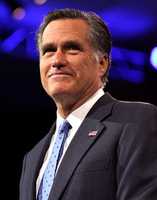

People Make Claims All The Time
“… our Navy is smaller than it's been since 1917", said Republican candidate Mitt Romney in third presidential debate in 2012.
http://en.wikipedia.org/wiki/Mitt_Romney
http://www.thebrainchildgroup.com/
©2015 The University of Texas at Arlington. All Rights Reserved.

Slide 9
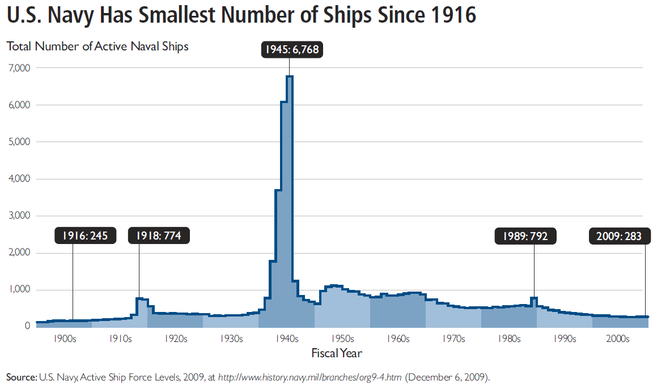
Fact Checking is not Easy
“… our Navy is smaller than it's been since 1917", said Republican candidate Mitt Romney in third presidential debate in 2012.
http://en.wikipedia.org/wiki/Mitt_Romney
http://s3.amazonaws.com/thf_media/2010/pdf/Military_chartbook.pdf
©2015 The University of Texas at Arlington. All Rights Reserved.

Slide 10
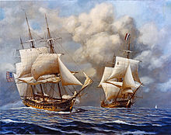
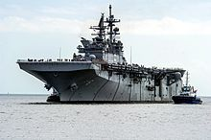
Fact Checking is not Easy
“… our Navy is smaller than it's been since 1917", said Republican candidate Mitt Romney in third presidential debate in 2012.
vs
http://en.wikipedia.org/wiki/Mitt_Romney
http://s3.amazonaws.com/thf_media/2010/pdf/Military_chartbook.pdf
http://en.wikipedia.org/wiki/United_States_Navy
©2015 The University of Texas at Arlington. All Rights Reserved.

Slide 11
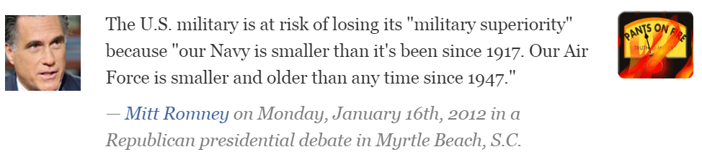
Existing Fact Checking Projects
Journalists and reporters spend good amount of time on fact checking
PolitiFact http://www.politifact.com/
FactCheckEU https://factcheckeu.org/
FullFact http://fullfact.org/
Snopes http://www.snopes.com/info/whatsnew.asp
Factcheck http://www.factcheck.org/
©2015 The University of Texas at Arlington. All Rights Reserved.

Slide 12
Numerous Claims to Check. Rise of Fact-Checkers
Republican candidate debate, August 6, 2015.¹
9 facts checked by factcheck.org
8 facts checked by CNN
24 facts checked by PolitiFact
64 active fact-checking sites in 2015, 44 in 2014. ²
http://time.com/3988276/republican-debate-primetime-transcript-full-text/
http://reporterslab.org/snapshot-of-fact-checking-around-the-world-july-2015/
©2015 The University of Texas at Arlington. All Rights Reserved.

Slide 13
Limitations of Current Fact-Checking Practices
Journalists spend hours going through documents to identify claims.
Significant time gap between speech and reporting times. Audience doesn’t get correct information.
Requires advanced writing skills to persuade readers. Such skilled writers are sparse.
Lack of Structured Journalism and use of old publishing frameworks hinders Semantic Web applications.
©2015 The University of Texas at Arlington. All Rights Reserved.

Slide 14
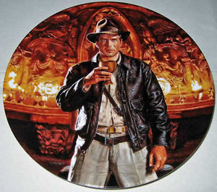
The Holy Grail: Automated, Live Fact-Checking
©2015 The University of Texas at Arlington. All Rights Reserved.

Slide 15
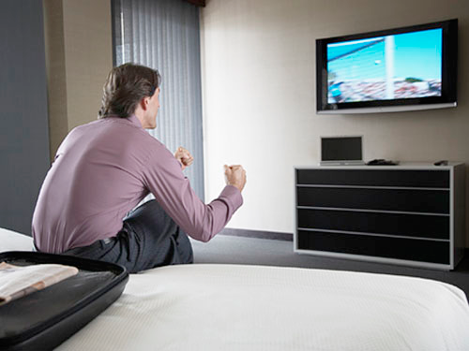
The Holy Grail
Source: Bill Adair
©2015 The University of Texas at Arlington. All Rights Reserved.

Slide 16

The Holy Grail
Source: Bill Adair
©2015 The University of Texas at Arlington. All Rights Reserved.

Slide 17

The Holy Grail
Source: Bill Adair
©2015 The University of Texas at Arlington. All Rights Reserved.

Slide 18

ClaimBuster
political discourses (debates, interviews), advertisements, live events on TV and online video streams
social media (e.g., twitter)
web pages
news articles
repository of already-checked claims
important factual claims
detector
matcher
no match
matched
assist data analysis; solicit analyses from professionals
display existing fact-checkers, delivered via browser extensions, mobile and smart-TV apps
www.wsandb.co.uk/wsb/news/2405401/european-court-rules-insurers-need-to-include-economic-consequences-of-policies#
www.outsidethebeltway.com
©2015 The University of Texas at Arlington. All Rights Reserved.

Slide 19
ClaimBuster
political discourses (debates, interviews), advertisements, live events on TV and online video streams
social media (e.g., twitter)
web pages
news articles
repository of already-checked claims
important factual claims
detector
matcher
no match
matched
assist data analysis; solicit analyses from professionals
display existing fact-checkers, delivered via browser extensions, mobile and smart-TV apps
www.wsandb.co.uk/wsb/news/2405401/european-court-rules-insurers-need-to-include-economic-consequences-of-policies#
www.outsidethebeltway.com
©2015 The University of Texas at Arlington. All Rights Reserved.

Slide 20
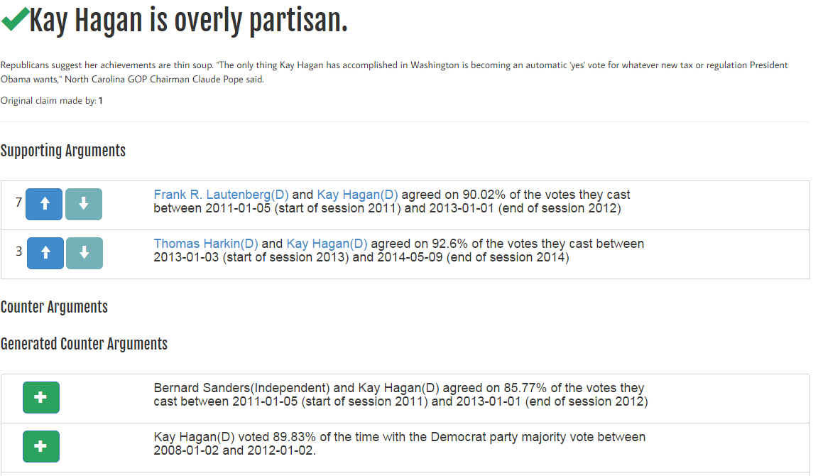
iCheck (Led by Duke)
©2015 The University of Texas at Arlington. All Rights Reserved.

Slide 21
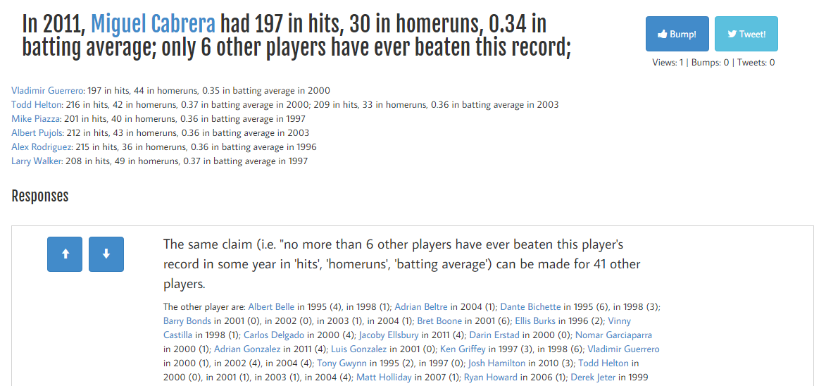
iCheck (Led by Duke)
©2015 The University of Texas at Arlington. All Rights Reserved.

Slide 22
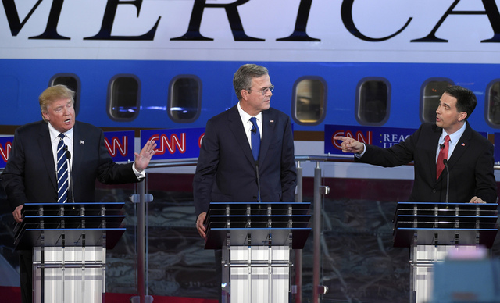
ClaimBuster to be 2016-Ready
Factual claims recommended to be checked
2016
Presidential
Debates
Journalists investigate the claims
(Speeches, debates, interviews, social media, news)
(or checked by algorithms, citizens, crowd)
©2015 The University of Texas at Arlington. All Rights Reserved.

Slide 23





Finding Important Factual Claims: A Classification Problem
2016
Presidential
Debates
Human Annotation
Feature Extraction
Learning Algorithm
Ground Truth
Feature Vectors
Presidential Debate Transcripts
Important factual claims
©2015 The University of Texas at Arlington. All Rights Reserved.

Slide 24
Dataset: Presidential Debate Transcripts
Source: http://www.debates.org/index.php?page=debate-transcripts
All 30 debates (11 elections) in history: 1960, 1976—2012
20k sentences by presidential candidates: removed very short (< 5 words) sentences
©2015 The University of Texas at Arlington. All Rights Reserved.

Slide 25
3 Classes of Sentences
Important factual claims
“We spend less on the military today than at any time in our history.” “The President’s position on gay marriage has changed.” “More people are unemployed today than four years ago.”
Unimportant factual claims
“I was in Iowa yesterday.” “My mother enjoys cooking.” “I ran for President once before.”
Sentences with no factual claims (just opinions, questions & declarations)
“Iran must not get nuclear weapons.” “7% unemployment is too high.” “My opponent is wishy-washy.” “I will be tough on crime.” "Why should we do that?“ “Hello, New Hampshire!” “Our plan is to reduce tax rate by 10%.”
Goal: Given a future sentence, find the class it belongs to.
©2015 The University of Texas at Arlington. All Rights Reserved.

Slide 26
Ground Truth Collection
Developed a data collection platform bit.ly/claimbusters.
In 3 months, we accumulated 226 participants.
Used 600 screening sentences to detect spammers & low-quality participants.
Admitted sentences which are agreed by at least 2 top-quality participants.
8015 such sentences.
Class | Count
CFS | 1673
UFS | 482
NFS | 5860
©2015 The University of Texas at Arlington. All Rights Reserved.

Slide 27
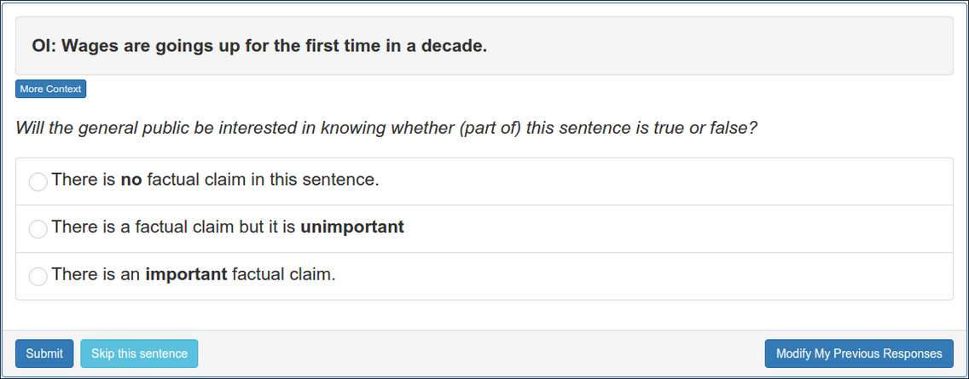
Ground Truth Collection Website
©2015 The University of Texas at Arlington. All Rights Reserved.

Slide 28
Feature Extraction
Keywords:
state, legislature, 87, percent, democrat
Sentiment: 0.032
I was in a state where my legislature was 87 percent Democrat.
Part-of-Speech:
Noun
Entity Type:
Quantity
Concept:
United States
Sentiment: [-1.0 to 1.0]
Words: tf-idf scores of 6130 words (excluding rare words)
POS Tag: 43 tags
Entity Type: 26 types
©2015 The University of Texas at Arlington. All Rights Reserved.

Slide 29
Feature Selection
6201 features in total
Used a Random Forest Classifier to calculate importance of each feature.
Most Important Feature: POS tag ‘Cardinal Number’
©2015 The University of Texas at Arlington. All Rights Reserved.

Slide 30
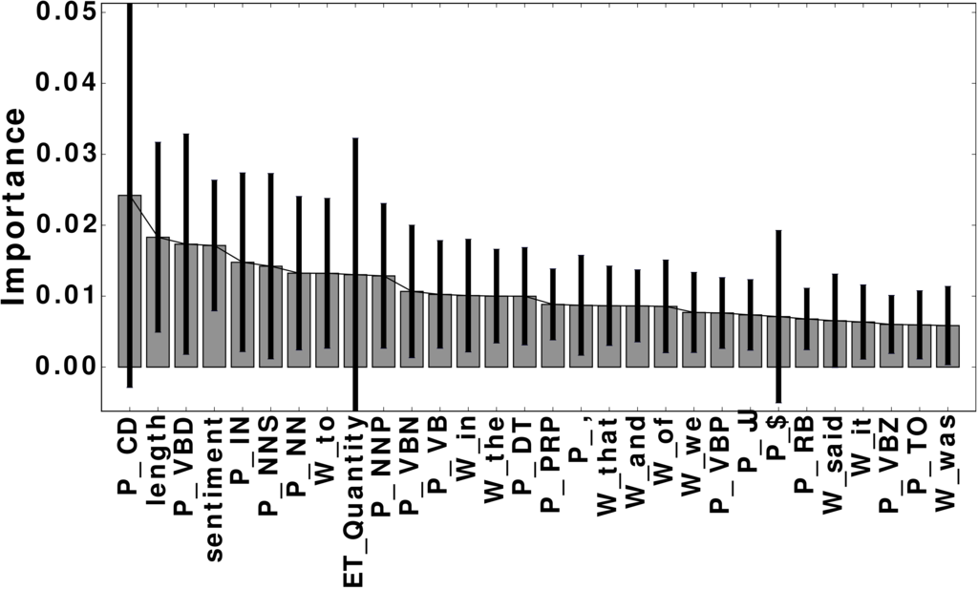
Important Features
Word | percent; people; jobs
POS tag | noun; cardinal number; past tense; preposition
Entity Type | Quantity; Country; FieldTerminology; Person
Concept | United States Senate; Barack Obama
©2015 The University of Texas at Arlington. All Rights Reserved.

Slide 31
Implementation: Python NLP/ML Tools
Data wrangling
Use NLTK (Natural Language Toolkit) to transform debate files into structured data format
Use mysql-python-connector to store extracted features into an MySQL database
Use matplotlib to plot classifiers’ performance.
Feature extraction
Use AlchemyAPI (Python wrapper) to extract rich features of sentences
Classification
Use scikit-learn to build classification models
©2015 The University of Texas at Arlington. All Rights Reserved.

Slide 32
Evaluation: Classification
4-fold cross validation
Algorithms: Naive Bayes, Random Forest & Support Vector Machine
Support Vector Machine performed better than others in general.
 | Precision | Recall | F-measure
NFS | 0.90 | 0.96 | 0.93
UFS | 0.65 | 0.26 | 0.37
CFS | 0.79 | 0.74 | 0.77
©2015 The University of Texas at Arlington. All Rights Reserved.

Slide 33
Evaluation: Ranking
Measured accuracy of top-K sentences.
ClaimBuster has a strong agreement with high-quality human coders on the check-worthiness of sentences
K | P@K | NDCG@K
25 | 1 | 1
50 | 1 | 1
100 | 0.960 | 0.970
200 | 0.940 | 0.951
300 | 0.853 | 0.881
500 | 0.690 | 0.840
©2015 The University of Texas at Arlington. All Rights Reserved.

Slide 34
Case Study: #GOPDebate2015
Near real-time experiment with 2015 first Republican primary debate
Transcript grabbed from closed captions of the Fox News channel using TextGrabber
1393 sentences
71% of the fact-checks from CNN, factcheck.org & PolitiFact were ranked by ClaimBuster within top 18%.
©2015 The University of Texas at Arlington. All Rights Reserved.

Slide 35
Case Study: #GOPDebate2015
CNN Claim | Associated sentence(s)[From TextGrabber] | Score
1 | Part of this iranian deal was lifting the international sanctions on general sulemani. | 0.415
2 | I would go on to add – >> you don’t favor – >> i have never said that. | 0.511
3 | A majority of the candidates on this stage supported amnesty. | 0.295
4 | Timely the medicaid is growing at one of the lowest rates in the country. | 0.534
4 | We went from $8 billion in the hole to $5 million in the black. | 0.773
5 | And the mexican government is much smarter, much sharper, much more cunning and they send the bad ones over because they don’t want to pay for them. | 0.215
6 | [Not found in the transcript] | N/A
©2015 The University of Texas at Arlington. All Rights Reserved.

Slide 36
Case Study: #GOPDebate2015
Real-time experiment with 2015 second Republican primary debate
Closed Captions from CNN channel
Tweeted important factual claims to https://twitter.com/ClaimBusterTM, live!
©2015 The University of Texas at Arlington. All Rights Reserved.

Slide 37
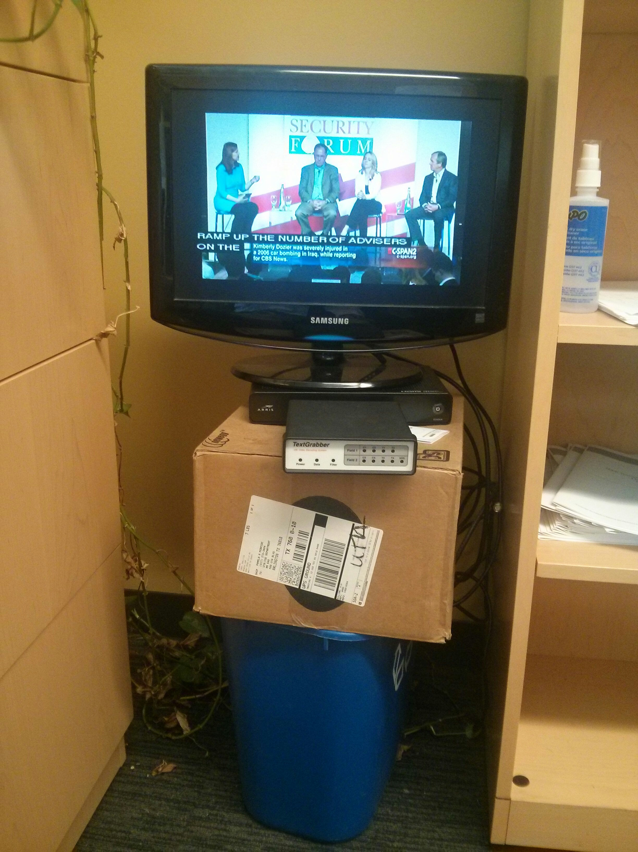
©2015 The University of Texas at Arlington. All Rights Reserved.

Slide 38
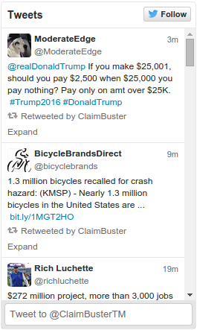
©2015 The University of Texas at Arlington. All Rights Reserved.

Slide 39
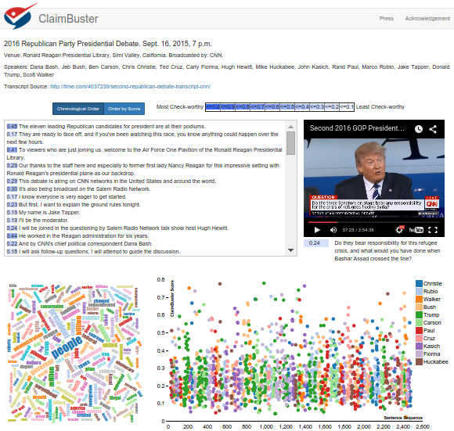

Demo
http://idir.uta.edu/claimbuster
©2015 The University of Texas at Arlington. All Rights Reserved.

Slide 40
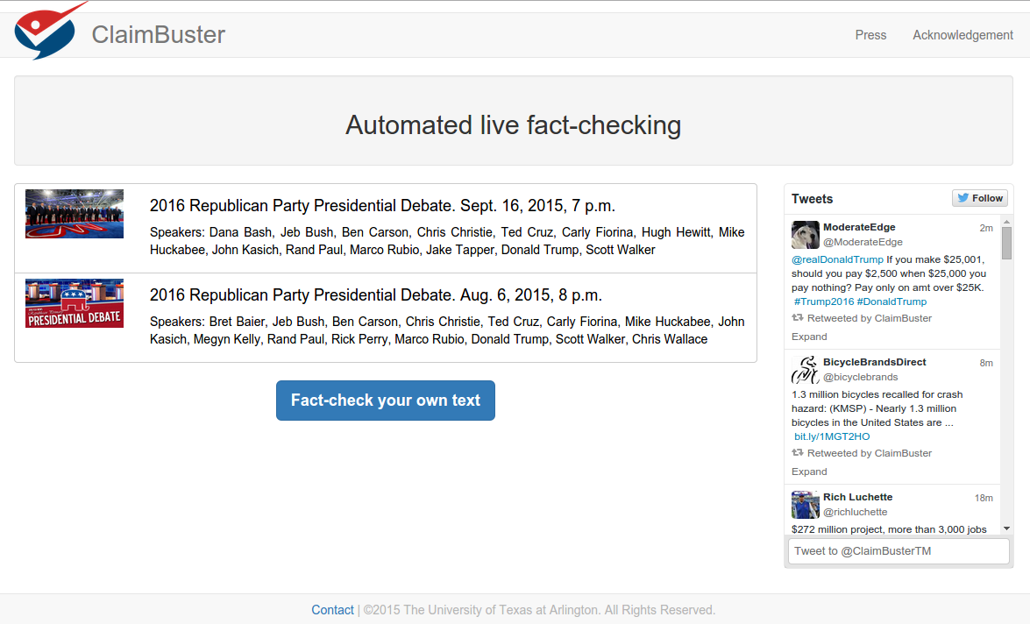
©2015 The University of Texas at Arlington. All Rights Reserved.

Slide 41
©2015 The University of Texas at Arlington. All Rights Reserved.

Slide 42
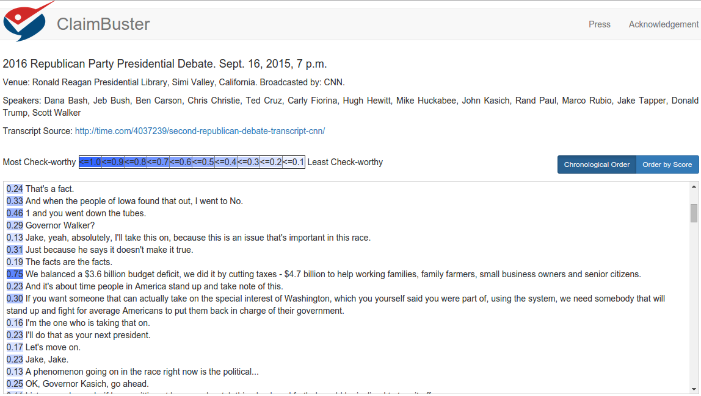
©2015 The University of Texas at Arlington. All Rights Reserved.

Slide 43
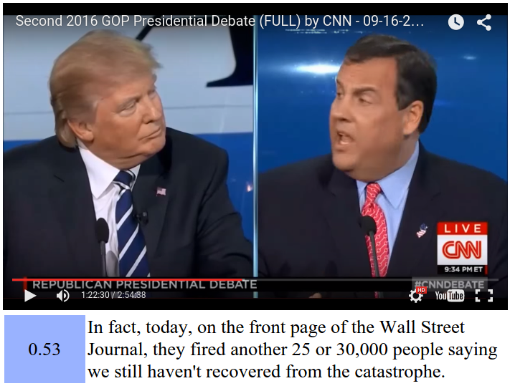
©2015 The University of Texas at Arlington. All Rights Reserved.

Slide 44
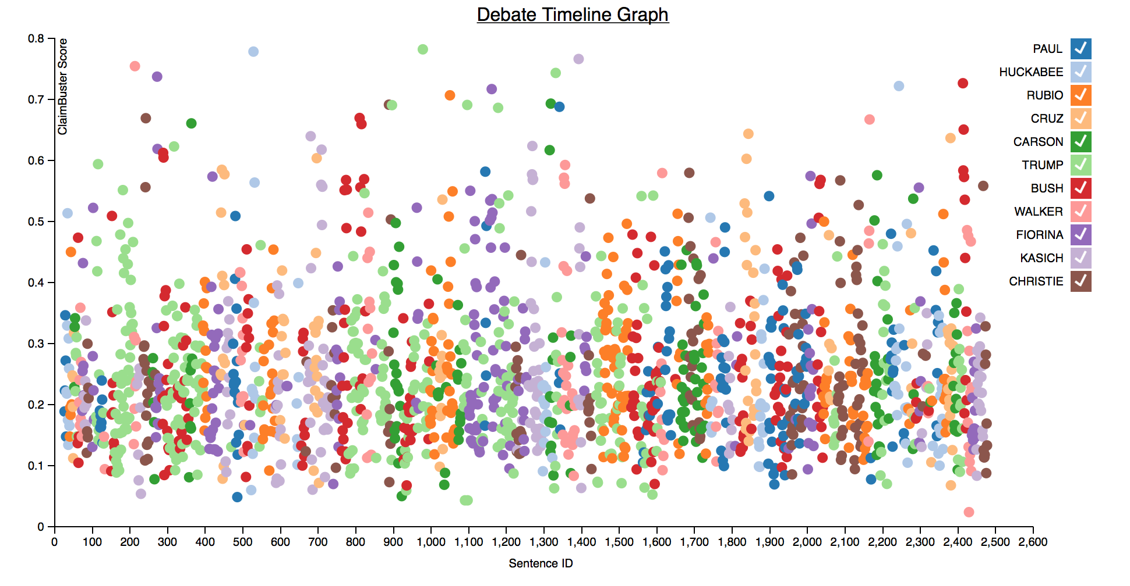
©2015 The University of Texas at Arlington. All Rights Reserved.

Slide 45
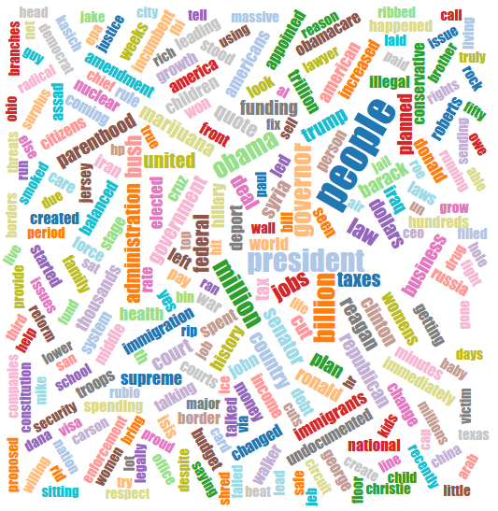
©2015 The University of Texas at Arlington. All Rights Reserved.

Slide 46
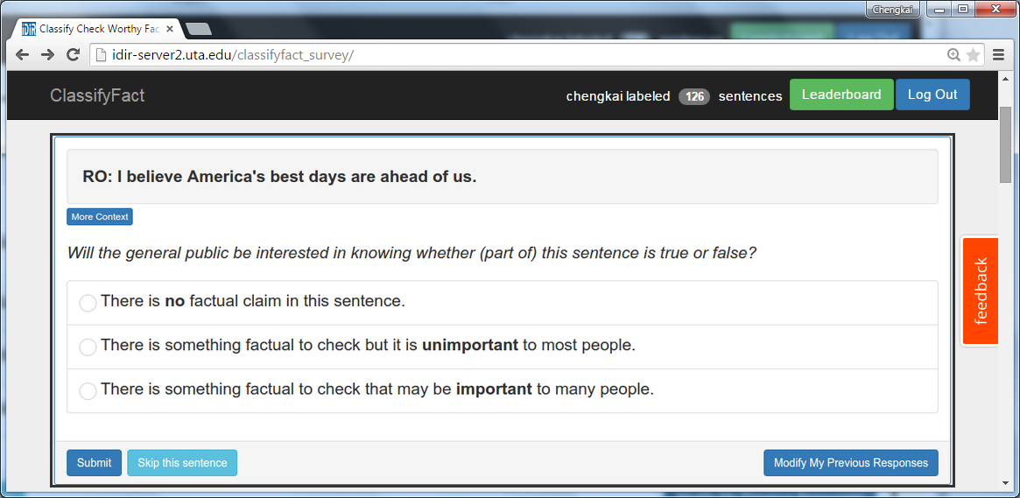

You are Invited
http://bit.ly/claimbusters
©2015 The University of Texas at Arlington. All Rights Reserved.

Slide 47
FactWatcher
Automated Monitoring of Facts from Real-World Events
©2015 The University of Texas at Arlington. All Rights Reserved.

Slide 48
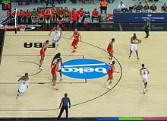
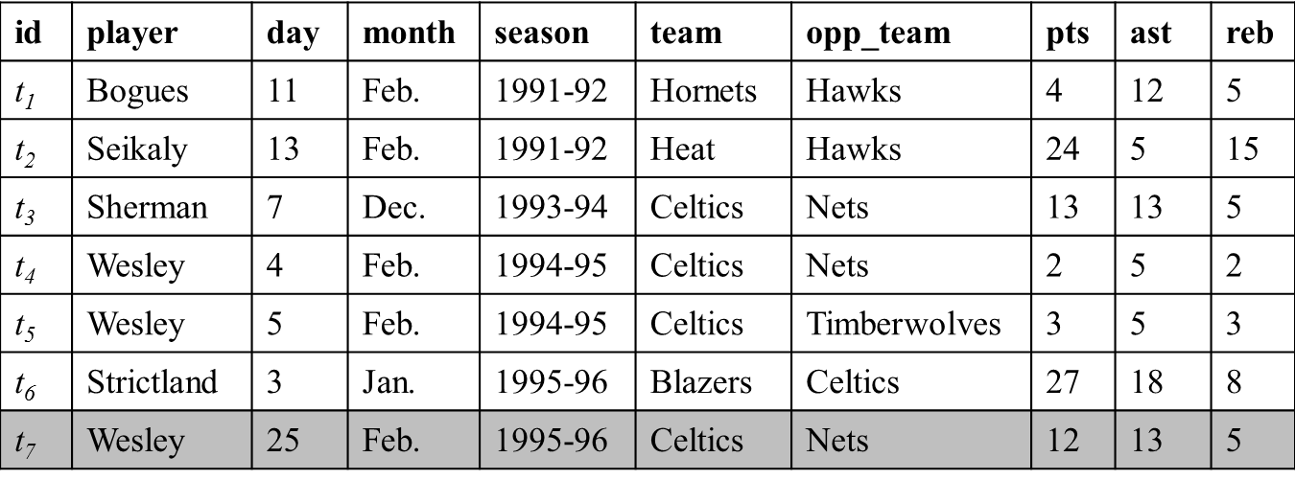
FactWatcher
Tuple t for new real world event appended to database
Constraint | Measure
month=Feb | pts, ast, reb
opp_team=Nets | ast, reb
team=Celtics & opp_team=Nets | ast, reb
… | …
Find constraint-measure pair (C, M) such that t is in the contextual skyline
Wesley had 12 points, 13 assists and 5 rebounds on February 25, 1996 to become the first player with a 12/13/5 (points/assists/rebounds) in February.
Generate factual claim
http://en.wikipedia.org/wiki/Basketball
©2015 The University of Texas at Arlington. All Rights Reserved.

Slide 49
FactWatcher Finds Three Types of Facts (and can be Extended)
Prominent streaks
Long consecutive subsequence of high values in a sequence
One-of-the-few objects
Qualifying statements that can only be made for very few objects
Situational facts
Comparison contexts and spaces that make a given object stand out
©2015 The University of Texas at Arlington. All Rights Reserved.

Slide 50
FactWatcher Finds Three Types of Facts (and can be Extended)
Domains
sports, weather, crimes, transportation, finance, social media analytics
Examples from Real News Media
Prominent streaks
“This month the Chinese capital has experienced 10 days with a maximum temperature in around 35 degrees Celsius – the most for the month of July in a decade.” http://www.chinadaily.com.cn/china/2010-07/27/content_11055675.htm
“The Nikkei 225 closed below 10000 for the 12th consecutive week, the longest such streak since June 2009.”
http://www.bloomberg.com/news/articles/2010-08-06/japanese-stocks-fall-for-second-day-this-week-on-u-s-jobless-claims-yen
©2015 The University of Texas at Arlington. All Rights Reserved.

Slide 51
FactWatcher Finds Three Types of Facts (and can be Extended)
Examples from Real News Media
Situational facts, One-of-the-few objects
“Paul George had 21 points, 11 rebounds and 5 assists to become the first Pacers player with a 20/10/5 (points/rebounds/assists) game against the Bulls since Detlef Schrempf in December 1992.” http://espn.go.com/espn/elias?date=20130205
“The social world’s most viral photo ever generated 3.5 million likes, 170,000 comments and 460,000 shares by Wednesday afternoon.” http://www.cnbc.com/id/49728455
©2015 The University of Texas at Arlington. All Rights Reserved.

Slide 52
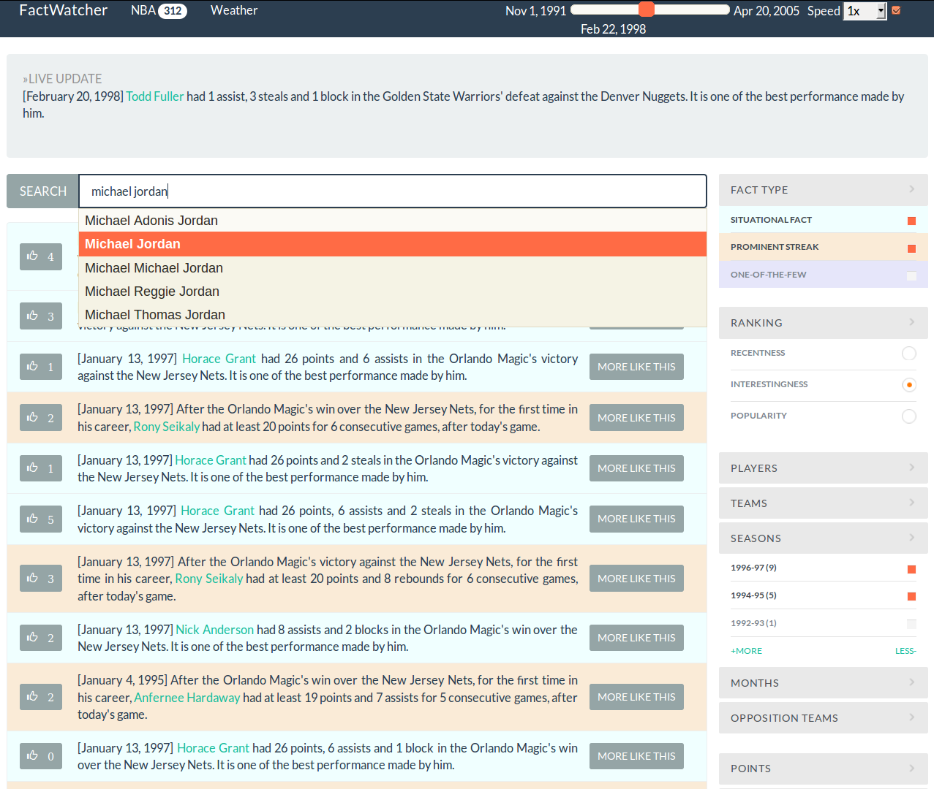


Presented In
Excellent Demo Award
http://idir.uta.edu/factwatcher/
©2015 The University of Texas at Arlington. All Rights Reserved.

Slide 53
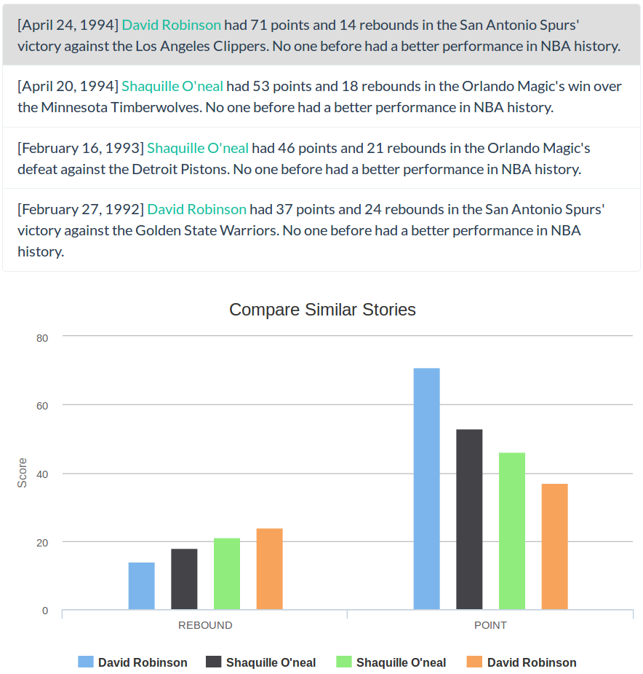
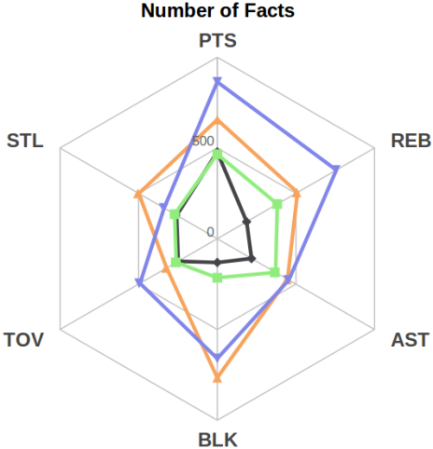
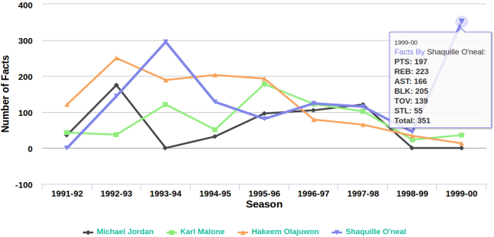
©2015 The University of Texas at Arlington. All Rights Reserved.

Slide 54
How were such Facts Discovered in Current Systems?
Our (educated?) guess
Experts monitor real-world events (e.g., watching an NBA game), have a gut-feeling, issue database queries, check out or not
Prepared facts-to-be (e.g., Nowitzki only needs 477 more points to surpass O'Neal. Perhaps will happen around Christmas 2015)
Predefined templates of facts/database queries
Perhaps in-house systems/algorithms similar to FactWatcher
©2015 The University of Texas at Arlington. All Rights Reserved.

Slide 55

Elias Sports Bureau
©2015 The University of Texas at Arlington. All Rights Reserved.

Slide 56
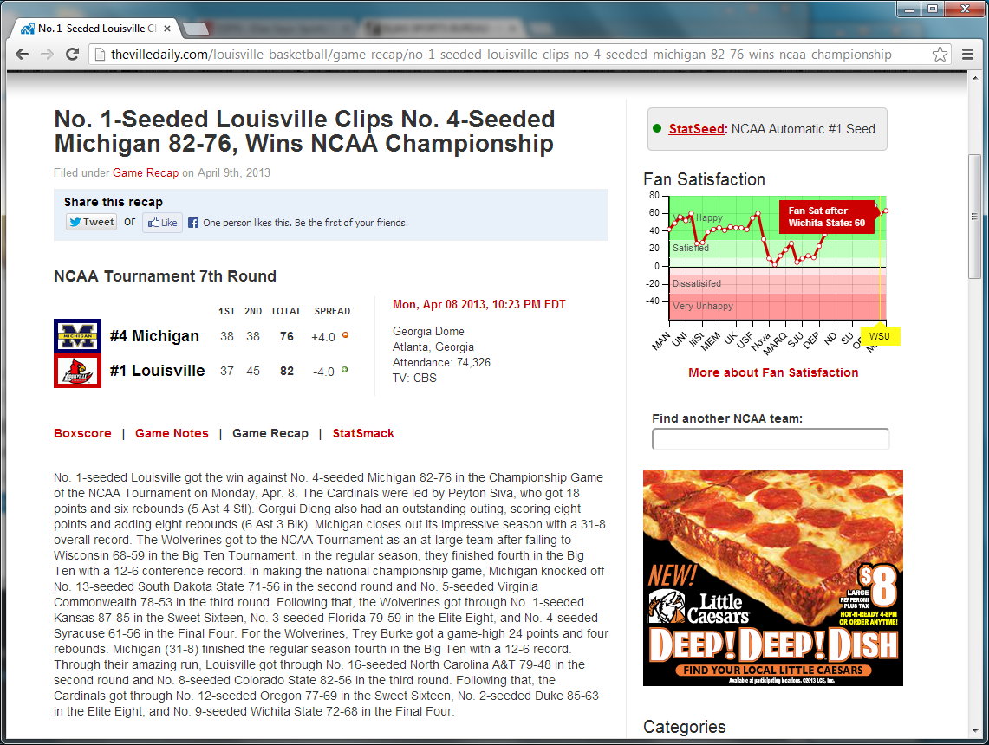
StatSheet
©2015 The University of Texas at Arlington. All Rights Reserved.

Slide 57
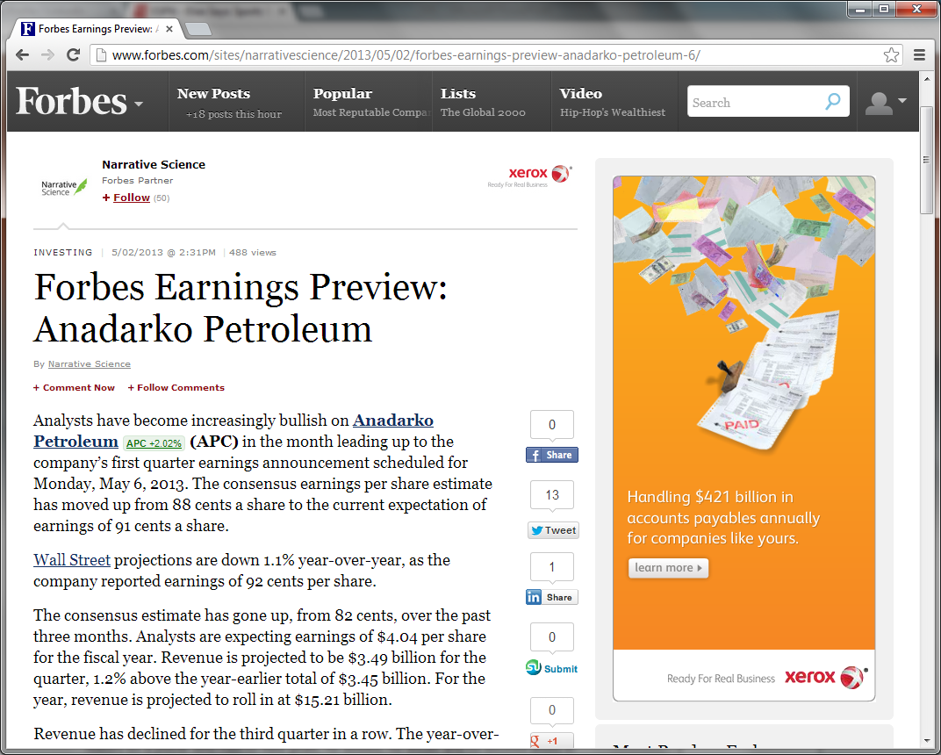
Narrative Science
©2015 The University of Texas at Arlington. All Rights Reserved.

Slide 58
Incremental Discovery of Prominent Situational Facts. Afroza Sultana, Naeemul Hassan, Chengkai Li, Jun Yang, Cong Yu. ICDE 2014, pages 112-123.
©2015 The University of Texas at Arlington. All Rights Reserved.

Slide 59
Situational Facts
“Paul George had 21 points, 11 rebounds and 5 assists to become the first Pacers player with a 20/10/5 (points/rebounds/assists) game against the Bulls since Detlef Schrempf in December 1992.”
(http://espn.go.com/espn/elias?date=20130205)
©2015 The University of Texas at Arlington. All Rights Reserved.

Slide 60
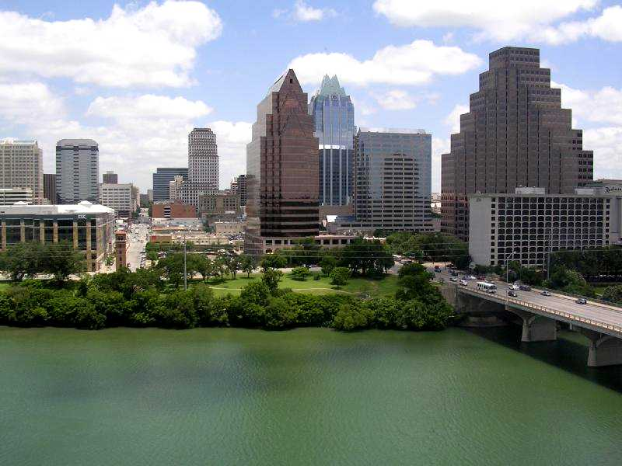
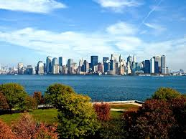
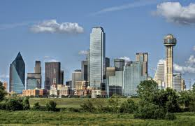
Skyline
www.rtkl.com
www.utepprintstore.com
jansport.com
©2015 The University of Texas at Arlington. All Rights Reserved.

Slide 61
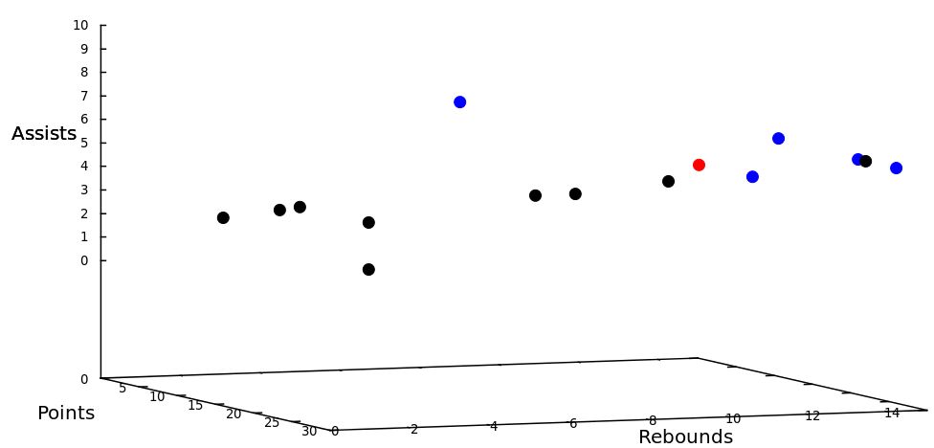
Situational Facts
“Paul George had 21 points, 11 rebounds and 5 assists to become the first Pacers player with a 20/10/5 (points/rebounds/assists) game against the Bulls since Detlef Schrempf in December 1992.”
(http://espn.go.com/espn/elias?date=20130205)
©2015 The University of Texas at Arlington. All Rights Reserved.

Slide 62
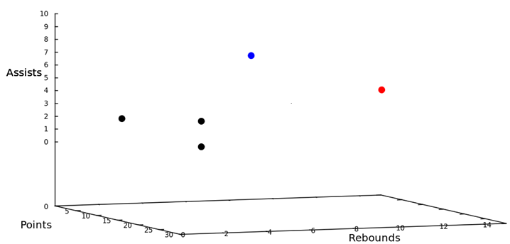
Situational Facts
“Paul George had 21 points, 11 rebounds and 5 assists to become the first Pacers player with a 20/10/5 (points/rebounds/assists) game against the Bulls since Detlef Schrempf in December 1992.”
(http://espn.go.com/espn/elias?date=20130205)
©2015 The University of Texas at Arlington. All Rights Reserved.

Slide 63
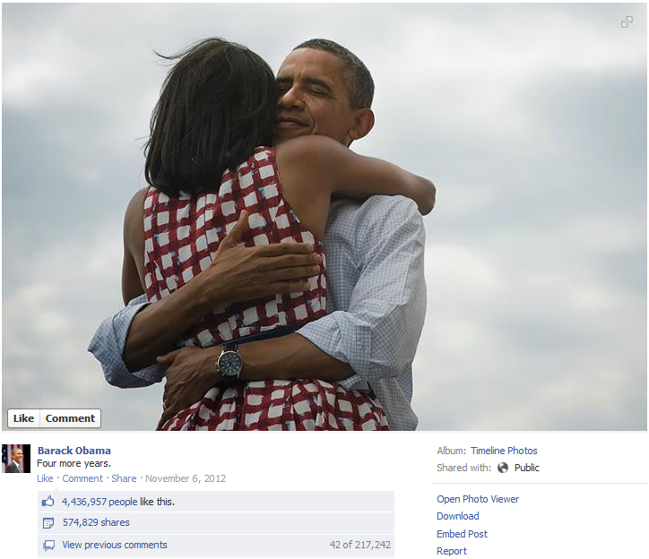
Situational Facts
“The social world’s most viral photo ever generated 3.5 million likes, 170,000 comments and 460,000 shares by Wednesday afternoon.”
(http://www.cnbc.com/id/49728455/President Obama Sets New Social Media Record)
©2015 The University of Texas at Arlington. All Rights Reserved.

Slide 64
Situational Facts
“The social world’s most viral photo ever generated 3.5 million likes, 170,000 comments and 460,000 shares by Wednesday afternoon.”
(http://www.cnbc.com/id/49728455/President Obama Sets New Social Media Record)
©2015 The University of Texas at Arlington. All Rights Reserved.

Slide 65
Situational Facts
“The social world’s most viral photo ever generated 3.5 million likes, 170,000 comments and 460,000 shares by Wednesday afternoon.”
(http://www.cnbc.com/id/49728455/President Obama Sets New Social Media Record)
©2015 The University of Texas at Arlington. All Rights Reserved.

Slide 66
Situational Facts
Stock Data: Stock A becomes the first stock in history with price over $300 and market cap over $400 billion.
Weather Data: Today’s measures of wind speed and humidity are x and y, respectively. City B has never encountered such high wind speed and humidity in March.
Criminal Records: There were 50 DUI arrests and 20 collisions in city C yesterday, the first time in 2013.
Financial Analyst
Journalists
Scientists
Citizens
©2015 The University of Texas at Arlington. All Rights Reserved.

Slide 67
A Mini-world of Basketball Gamelogs
id | player | day | month | season | team | opp_team | pts | ast | reb
t₁ | Bogues | 11 | Feb. | 1991-92 | Hornets | Hawks | 4 | 12 | 5
t₂ | Seikaly | 13 | Feb. | 1991-92 | Heat | Hawks | 24 | 5 | 15
t₃ | Sherman | 7 | Dec. | 1993-94 | Celtics | Nets | 13 | 13 | 5
t₄ | Wesley | 4 | Feb. | 1994-95 | Celtics | Nets | 2 | 5 | 2
t₅ | Wesley | 5 | Feb. | 1994-95 | Celtics | Timberwolves | 3 | 5 | 3
t₆ | Strictland | 3 | Jan. | 1995-96 | Blazers | Celtics | 27 | 18 | 8
t₇ | Wesley | 25 | Feb. | 1995-96 | Celtics | Nets | 12 | 13 | 5
Last tuple appended to table
©2015 The University of Texas at Arlington. All Rights Reserved.

Slide 68
A Mini-world of Basketball Gamelogs
id | player | day | month | season | team | opp_team | pts | ast | reb
t₁ | Bogues | 11 | Feb. | 1991-92 | Hornets | Hawks | 4 | 12 | 5
t₂ | Seikaly | 13 | Feb. | 1991-92 | Heat | Hawks | 24 | 5 | 15
t₃ | Sherman | 7 | Dec. | 1993-94 | Celtics | Nets | 13 | 13 | 5
t₄ | Wesley | 4 | Feb. | 1994-95 | Celtics | Nets | 2 | 5 | 2
t₅ | Wesley | 5 | Feb. | 1994-95 | Celtics | Timberwolves | 3 | 5 | 3
t₆ | Strictland | 3 | Jan. | 1995-96 | Blazers | Celtics | 27 | 18 | 8
t₇ | Wesley | 25 | Feb. | 1995-96 | Celtics | Nets | 12 | 13 | 5
©2015 The University of Texas at Arlington. All Rights Reserved.

Slide 69
A Mini-world of Basketball Gamelogs
id | player | day | month | season | team | opp_team | pts | ast | reb
t₁ | Bogues | 11 | Feb. | 1991-92 | Hornets | Hawks | 4 | 12 | 5
t₂ | Seikaly | 13 | Feb. | 1991-92 | Heat | Hawks | 24 | 5 | 15
t₃ | Sherman | 7 | Dec. | 1993-94 | Celtics | Nets | 13 | 13 | 5
t₄ | Wesley | 4 | Feb. | 1994-95 | Celtics | Nets | 2 | 5 | 2
t₅ | Wesley | 5 | Feb. | 1994-95 | Celtics | Timberwolves | 3 | 5 | 3
t₆ | Strictland | 3 | Jan. | 1995-96 | Blazers | Celtics | 27 | 18 | 8
t₇ | Wesley | 25 | Feb. | 1995-96 | Celtics | Nets | 12 | 13 | 5
©2015 The University of Texas at Arlington. All Rights Reserved.

Slide 70
A Mini-world of Basketball Gamelogs
id | player | day | month | season | team | opp_team | pts | ast | reb
t₁ | Bogues | 11 | Feb. | 1991-92 | Hornets | Hawks | 4 | 12 | 5
t₂ | Seikaly | 13 | Feb. | 1991-92 | Heat | Hawks | 24 | 5 | 15
t₃ | Sherman | 7 | Dec. | 1993-94 | Celtics | Nets | 13 | 13 | 5
t₄ | Wesley | 4 | Feb. | 1994-95 | Celtics | Nets | 2 | 5 | 2
t₅ | Wesley | 5 | Feb. | 1994-95 | Celtics | Timberwolves | 3 | 5 | 3
t₆ | Strictland | 3 | Jan. | 1995-96 | Blazers | Celtics | 27 | 18 | 8
t₇ | Wesley | 25 | Feb. | 1995-96 | Celtics | Nets | 12 | 13 | 5
Wesley had 12 points, 13 assists and 5 rebounds on February 25, 1996 to become the first player with a 12/13/5 (points/assists/rebounds) in February.
©2015 The University of Texas at Arlington. All Rights Reserved.

Slide 71
A Mini-world of Basketball Gamelogs
id | player | day | month | season | team | opp_team | pts | ast | reb
t₁ | Bogues | 11 | Feb. | 1991-92 | Hornets | Hawks | 4 | 12 | 5
t₂ | Seikaly | 13 | Feb. | 1991-92 | Heat | Hawks | 24 | 5 | 15
t₃ | Sherman | 7 | Dec. | 1993-94 | Celtics | Nets | 13 | 13 | 5
t₄ | Wesley | 4 | Feb. | 1994-95 | Celtics | Nets | 2 | 5 | 2
t₅ | Wesley | 5 | Feb. | 1994-95 | Celtics | Timberwolves | 3 | 5 | 3
t₆ | Strictland | 3 | Jan. | 1995-96 | Blazers | Celtics | 27 | 18 | 8
t₇ | Wesley | 25 | Feb. | 1995-96 | Celtics | Nets | 12 | 13 | 5
©2015 The University of Texas at Arlington. All Rights Reserved.

Slide 72
A Mini-world of Basketball Gamelogs
id | player | day | month | season | team | opp_team | pts | ast | reb
t₁ | Bogues | 11 | Feb. | 1991-92 | Hornets | Hawks | 4 | 12 | 5
t₂ | Seikaly | 13 | Feb. | 1991-92 | Heat | Hawks | 24 | 5 | 15
t₃ | Sherman | 7 | Dec. | 1993-94 | Celtics | Nets | 13 | 13 | 5
t₄ | Wesley | 4 | Feb. | 1994-95 | Celtics | Nets | 2 | 5 | 2
t₅ | Wesley | 5 | Feb. | 1994-95 | Celtics | Timberwolves | 3 | 5 | 3
t₆ | Strictland | 3 | Jan. | 1995-96 | Blazers | Celtics | 27 | 18 | 8
t₇ | Wesley | 25 | Feb. | 1995-96 | Celtics | Nets | 12 | 13 | 5
Wesley had 13 assists and 5 rebounds on February 25, 1996 to become the second Celtics player with a 13/5 (assists/rebounds) game against the Nets.
©2015 The University of Texas at Arlington. All Rights Reserved.

Slide 73
Problem Definition
Dimension space: D={d₁,… ,d_{n}}
Measure space: M ={m₁,… ,m_{s}}
id | player | day | month | season | team | opp_team | pts | ast | reb
t₁ | Bogues | 11 | Feb. | 1991-92 | Hornets | Hawks | 4 | 12 | 5
t₂ | Seikaly | 13 | Feb. | 1991-92 | Heat | Hawks | 24 | 5 | 15
t₃ | Sherman | 7 | Dec. | 1993-94 | Celtics | Nets | 13 | 13 | 5
t₄ | Wesley | 4 | Feb. | 1994-95 | Celtics | Nets | 2 | 5 | 2
t₅ | Wesley | 5 | Feb. | 1994-95 | Celtics | Timberwolves | 3 | 5 | 3
t₆ | Strictland | 3 | Jan. | 1995-96 | Blazers | Celtics | 27 | 18 | 8
append-only table
©2015 The University of Texas at Arlington. All Rights Reserved.

Slide 74
Problem Definition
Constraint (C): d₁=v₁∧d₂=v₂∧. . . ∧ d_{n}=v_{n}, v_{i}∈dom(d_{i})∪{∗}
team=Celtics ∧ opp_team=Nets
id | player | day | month | season | team | opp_team | pts | ast | rb
t₁ | Bogues | 11 | Feb. | 1991-92 | Hornets | Hawks | 4 | 12 | 5
t₂ | Seikaly | 13 | Feb. | 1991-92 | Heat | Hawks | 24 | 5 | 15
t₃ | Sherman | 7 | Dec. | 1993-94 | Celtics | Nets | 13 | 13 | 5
t₄ | Wesley | 4 | Feb. | 1994-95 | Celtics | Nets | 2 | 5 | 2
t₅ | Wesley | 5 | Feb. | 1994-95 | Celtics | Timberwolves | 3 | 5 | 3
t₆ | Strictland | 3 | Jan. | 1995-96 | Blazers | Celtics | 27 | 18 | 8
©2015 The University of Texas at Arlington. All Rights Reserved.

Slide 75
Problem Definition
Constraint-Measure Pair (C, M): Combination of a constraint and measure subspace
(team=Celtics ∧ opp_team=Nets,{assists,rebounds})
id | player | day | month | season | team | opp_team | pts | ast | reb
t₁ | Bogues | 11 | Feb. | 1991-92 | Hornets | Hawks | 4 | 12 | 5
t₂ | Seikaly | 13 | Feb. | 1991-92 | Heat | Hawks | 24 | 5 | 15
t₃ | Sherman | 7 | Dec. | 1993-94 | Celtics | Nets | 13 | 13 | 5
t₄ | Wesley | 4 | Feb. | 1994-95 | Celtics | Nets | 2 | 5 | 2
t₅ | Wesley | 5 | Feb. | 1994-95 | Celtics | Timberwolves | 3 | 5 | 3
t₆ | Strictland | 3 | Jan. | 1995-96 | Blazers | Celtics | 27 | 18 | 8
©2015 The University of Texas at Arlington. All Rights Reserved.

Slide 76
Problem Definition
Contextual skyline: skyline regarding (C, M)
σ_{team=Celtics ∧ opp_team=Nets}(R), M={assists,rebounds}
{t₃}
id | player | day | month | season | team | opp_team | pts | ast | reb
t₁ | Bogues | 11 | Feb. | 1991-92 | Hornets | Hawks | 4 | 12 | 5
t₂ | Seikaly | 13 | Feb. | 1991-92 | Heat | Hawks | 24 | 5 | 15
t₃ | Sherman | 7 | Dec. | 1993-94 | Celtics | Nets | 13 | 13 | 5
t₄ | Wesley | 4 | Feb. | 1994-95 | Celtics | Nets | 2 | 5 | 2
t₅ | Wesley | 5 | Feb. | 1994-95 | Celtics | Timberwolves | 3 | 5 | 3
t₆ | Strictland | 3 | Jan. | 1995-96 | Blazers | Celtics | 27 | 18 | 8
©2015 The University of Texas at Arlington. All Rights Reserved.

Slide 77
FactWatcher
Tuple t for new real world event appended to database
Constraint | Measure
month=Feb | pts, ast, reb
opp_team=Nets | ast, reb
team=Celtics & opp_team=Nets | ast, reb
… | …
Find constraint-measure pair (C, M) such that t is in the contextual skyline
Wesley had 12 points, 13 assists and 5 rebounds on February 25, 1996 to become the first player with a 12/13/5 (points/assists/rebounds) in February.
Generate factual claim
http://en.wikipedia.org/wiki/Basketball
©2015 The University of Texas at Arlington. All Rights Reserved.

Slide 78
Related Work
Conventional skyline analysis (Borzsonyi et al. ICDE 2001)
Q: context, measure subspace A: contextual skyline tuples
Our focus--- A: tuple Q: constraint-measure pairs
©2015 The University of Texas at Arlington. All Rights Reserved.

Slide 79
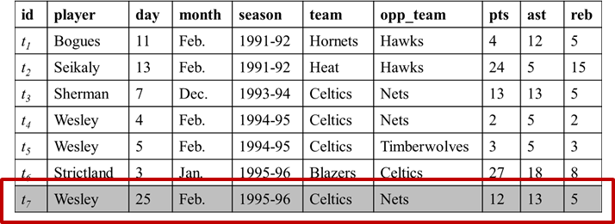
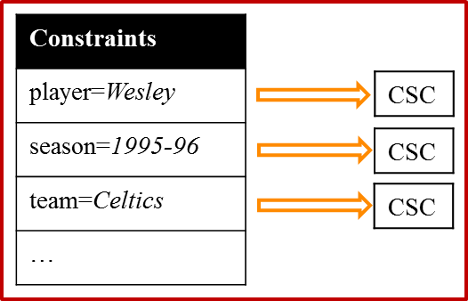
Related Works
Compressed Skycube (Xia et al. SIGMOD 2006)
Update compressed skycube in monitoring fashion
We adapted CSC for each constraint: Constraint-CSC
Constraint | Measure
month=Feb | pts, ast, reb
opp_team=Nets | ast, reb
team=Celtics & opp_team=Nets | ast, reb
… | …
Query
©2015 The University of Texas at Arlington. All Rights Reserved.

Slide 80
Related Works
Prominent Analysis by Ranking (Wu et. Al. VLDB 2009)
Static data, onetime query
We dealt on continuous data, standing query
Find the contexts where an object is ranked high in a single scoring attribute
We considered skyline on multiple measure subspaces
©2015 The University of Texas at Arlington. All Rights Reserved.

Slide 81
Modeling
Τ
{t₁,t₂,t₃,t₄,t₅}
id | d₁ | d₂ | d₃ | m₁ | m₂
t₁ | a₁ | b₂ | c₂ | 10 | 15
t₂ | a₁ | b₁ | c₁ | 15 | 10
t₃ | a₂ | b₁ | c₂ | 17 | 17
t₄ | a₂ | b₁ | c₁ | 20 | 20
t₅ | a₁ | b₁ | c₁ | 11 | 15
a₁
{t₁,t₂,t₅}
b₁
{t₂,t₃,t₄,t₅}
c₁
{t₂,t₄,t₅}
a₁,b₁
{t₂,t₅}
a₁,c₁
{t₂,t₅}
b₁,c₁
{t₂,t₄,t₅}
a₁,b₁,c₁
{t₂,t₅}
d₁=a₁ ∧ d₂=b₁ ∧ d₃=c₁
Lattice of C ^{t5}
Tuple Satisfied Constraint C ^{t} : If ∀d_{i}∈D, C.d_{i}=∗ or C.d_{i}=t.d_{i}, t satisfies C.
©2015 The University of Texas at Arlington. All Rights Reserved.

Slide 82
Modeling
Lattice of C ^{t4}
Τ
id | d₁ | d₂ | d₃ | m₁ | m₂
t₁ | a₁ | b₂ | c₂ | 10 | 15
t₂ | a₁ | b₁ | c₁ | 15 | 10
t₃ | a₂ | b₁ | c₂ | 17 | 17
t₄ | a₂ | b₁ | c₁ | 20 | 20
t₅ | a₁ | b₁ | c₁ | 11 | 15
a₁
a₂
b₁
c₁
a₁,b₁
a₂,b₁
a₁,c₁
a₂,c₁
b₁,c₁
a₁,b₁,c₁
a₂,b₁,c₁
Lattice of C ^{t5}
©2015 The University of Texas at Arlington. All Rights Reserved.

Slide 83
Modeling
Lattice of C ^{t4}
Τ
id | d₁ | d₂ | d₃ | m₁ | m₂
t₁ | a₁ | b₂ | c₂ | 10 | 15
t₂ | a₁ | b₁ | c₁ | 15 | 10
t₃ | a₂ | b₁ | c₂ | 17 | 17
t₄ | a₂ | b₁ | c₁ | 20 | 20
t₅ | a₁ | b₁ | c₁ | 11 | 15
a₁
a₂
b₁
c₁
a₁,b₁
a₂,b₁
a₁,c₁
a₂,c₁
b₁,c₁
a₁,b₁,c₁
a₂,b₁,c₁
Lattice of C ^{t5}
Lattice Intersection: C ^{t4,t5}=C ^{t4}∩C ^{t5}
©2015 The University of Texas at Arlington. All Rights Reserved.

Slide 84
Brute-Force Approach
Τ
id | d₁ | d₂ | d₃ | m₁ | m₂
t₁ | a₁ | b₂ | c₂ | 10 | 15
t₂ | a₁ | b₁ | c₁ | 15 | 10
t₃ | a₂ | b₁ | c₂ | 17 | 17
t₄ | a₂ | b₁ | c₁ | 20 | 20
t₅ | a₁ | b₁ | c₁ | 11 | 15
a₁
b₁
c₁
a₁,b₁
a₁,c₁
b₁,c₁
a₁,b₁,c₁
©2015 The University of Texas at Arlington. All Rights Reserved.

Slide 85
Brute-Force Approach
Τ
id | d₁ | d₂ | d₃ | m₁ | m₂
t₁ | a₁ | b₂ | c₂ | 10 | 15
t₂ | a₁ | b₁ | c₁ | 15 | 10
t₃ | a₂ | b₁ | c₂ | 17 | 17
t₄ | a₂ | b₁ | c₁ | 20 | 20
t₅ | a₁ | b₁ | c₁ | 11 | 15
a₁
b₁
c₁
a₁,b₁
a₁,c₁
b₁,c₁
a₁,b₁,c₁
©2015 The University of Texas at Arlington. All Rights Reserved.

Slide 86
Brute-Force Approach
Τ
id | d₁ | d₂ | d₃ | m₁ | m₂
t₁ | a₁ | b₂ | c₂ | 10 | 15
t₂ | a₁ | b₁ | c₁ | 15 | 10
t₃ | a₂ | b₁ | c₂ | 17 | 17
t₄ | a₂ | b₁ | c₁ | 20 | 20
t₅ | a₁ | b₁ | c₁ | 11 | 15
a₁
b₁
c₁
a₁,b₁
a₁,c₁
b₁,c₁
a₁,b₁,c₁
©2015 The University of Texas at Arlington. All Rights Reserved.

Slide 87
Brute-Force Approach
Τ
id | d₁ | d₂ | d₃ | m₁ | m₂
t₁ | a₁ | b₂ | c₂ | 10 | 15
t₂ | a₁ | b₁ | c₁ | 15 | 10
t₃ | a₂ | b₁ | c₂ | 17 | 17
t₄ | a₂ | b₁ | c₁ | 20 | 20
t₅ | a₁ | b₁ | c₁ | 11 | 15
a₁
b₁
c₁
a₁,b₁
a₁,c₁
b₁,c₁
a₁,b₁,c₁
©2015 The University of Texas at Arlington. All Rights Reserved.

Slide 88
Brute-Force Approach
Τ
id | d₁ | d₂ | d₃ | m₁ | m₂
t₁ | a₁ | b₂ | c₂ | 10 | 15
t₂ | a₁ | b₁ | c₁ | 15 | 10
t₃ | a₂ | b₁ | c₂ | 17 | 17
t₄ | a₂ | b₁ | c₁ | 20 | 20
t₅ | a₁ | b₁ | c₁ | 11 | 15
a₁
b₁
c₁
a₁,b₁
a₁,c₁
b₁,c₁
a₁,b₁,c₁
©2015 The University of Texas at Arlington. All Rights Reserved.

Slide 89
Brute-Force Approach
Τ
id | d₁ | d₂ | d₃ | m₁ | m₂
t₁ | a₁ | b₂ | c₂ | 10 | 15
t₂ | a₁ | b₁ | c₁ | 15 | 10
t₃ | a₂ | b₁ | c₂ | 17 | 17
t₄ | a₂ | b₁ | c₁ | 20 | 20
t₅ | a₁ | b₁ | c₁ | 11 | 15
a₁
b₁
c₁
a₁,b₁
a₁,c₁
b₁,c₁
a₁,b₁,c₁
©2015 The University of Texas at Arlington. All Rights Reserved.

Slide 90
Brute-Force Approach
Τ
id | d₁ | d₂ | d₃ | m₁ | m₂
t₁ | a₁ | b₂ | c₂ | 10 | 15
t₂ | a₁ | b₁ | c₁ | 15 | 10
t₃ | a₂ | b₁ | c₂ | 17 | 17
t₄ | a₂ | b₁ | c₁ | 20 | 20
t₅ | a₁ | b₁ | c₁ | 11 | 15
a₁
b₁
c₁
a₁,b₁
a₁,c₁
b₁,c₁
a₁,b₁,c₁
Total |R|*(2^{|D|+|M|}-1) comparisons!
Total 16 comparisons in this case!
©2015 The University of Texas at Arlington. All Rights Reserved.

Slide 91
Challenges
Exhaustive comparison with every tuple
Under every constraint
Over every measure subspace
©2015 The University of Texas at Arlington. All Rights Reserved.

Slide 92
Challenges and Ideas
Exhaustive comparison with every tuple
Tuple reduction
Comparison with skyline tuples is enough
t₄≻_{{m1,m2}}t₃≻_{{m1,m2}}t₅ => t₄≻_{{m1,m2}}t₅
id | d₁ | d₂ | d₃ | m₁ | m₂
t₁ | a₁ | b₂ | c₂ | 10 | 15
t₂ | a₁ | b₁ | c₁ | 15 | 10
t₃ | a₂ | b₁ | c₂ | 17 | 17
t₄ | a₂ | b₁ | c₁ | 20 | 20
t₅ | a₁ | b₁ | c₁ | 11 | 15
©2015 The University of Texas at Arlington. All Rights Reserved.

Slide 93
Challenges and Ideas
Under every constraint
Constraint pruning
In C ^{t,t'}, one comparison on t and t' is enough
Τ
id | d₁ | d₂ | d₃ | m₁ | m₂
t₁ | a₁ | b₂ | c₂ | 10 | 15
t₂ | a₁ | b₁ | c₁ | 15 | 10
t₃ | a₂ | b₁ | c₂ | 17 | 17
t₄ | a₂ | b₁ | c₁ | 20 | 20
t₅ | a₁ | b₁ | c₁ | 11 | 15
a₁
b₁
c₁
a₁,b₁
a₁,c₁
b₁,c₁
a₁,b₁,c₁
©2015 The University of Texas at Arlington. All Rights Reserved.

Slide 94
Challenges and Ideas
Under every constraint
Constraint pruning
In C ^{t,t'}, one comparison on t and t' is enough
Τ
id | d₁ | d₂ | d₃ | m₁ | m₂
t₁ | a₁ | b₂ | c₂ | 10 | 15
t₂ | a₁ | b₁ | c₁ | 15 | 10
t₃ | a₂ | b₁ | c₂ | 17 | 17
t₄ | a₂ | b₁ | c₁ | 20 | 20
t₅ | a₁ | b₁ | c₁ | 11 | 15
a₁
b₁
c₁
a₁,b₁
a₁,c₁
b₁,c₁
a₁,b₁,c₁
©2015 The University of Texas at Arlington. All Rights Reserved.

Slide 95
Challenges and Ideas
Over every measure subspace
Sharing computation across measure subspaces
Reusing computations on full space in subspaces
Τ
id | d₁ | d₂ | d₃ | m₁ | m₂
t₁ | a₁ | b₂ | c₂ | 10 | 15
t₂ | a₁ | b₁ | c₁ | 15 | 10
t₃ | a₂ | b₁ | c₂ | 17 | 17
t₄ | a₂ | b₁ | c₁ | 20 | 20
t₅ | a₁ | b₁ | c₁ | 11 | 15
a₁
b₁
c₁
a₁,b₁
a₁,c₁
b₁,c₁
a₁,b₁,c₁
©2015 The University of Texas at Arlington. All Rights Reserved.

Slide 96
Challenges and Ideas
Over every measure subspace
Sharing computation across measure subspaces
Reusing computations on full space in subspaces
Τ
id | d₁ | d₂ | d₃ | m₁ | m₂
t₁ | a₁ | b₂ | c₂ | 10 | 15
t₂ | a₁ | b₁ | c₁ | 15 | 10
t₃ | a₂ | b₁ | c₂ | 17 | 17
t₄ | a₂ | b₁ | c₁ | 20 | 20
t₅ | a₁ | b₁ | c₁ | 11 | 15
a₁
b₁
c₁
a₁,b₁
a₁,c₁
b₁,c₁
a₁,b₁,c₁
©2015 The University of Texas at Arlington. All Rights Reserved.

Slide 97
Our Algorithms
Tuple reduction + Constraint pruning
BottomUp
TopDown
Tuple reduction + Constraint pruning + Sharing computation
SBottomUp
STopDown
©2015 The University of Texas at Arlington. All Rights Reserved.

Slide 98
BottomUp
Stores a tuple for every such constraint that qualifies it as a contextual skyline tuple
Traverses the constraints in C ^{t} in a bottom-up, breadth-first manner
©2015 The University of Texas at Arlington. All Rights Reserved.

Slide 99
BottomUp
id | d₁ | d₂ | d₃ | m₁ | m₂
t₁ | a₁ | b₂ | c₂ | 10 | 15
t₂ | a₁ | b₁ | c₁ | 15 | 10
t₃ | a₂ | b₁ | c₂ | 17 | 17
t₄ | a₂ | b₁ | c₁ | 20 | 20
t₅ | a₁ | b₁ | c₁ | 11 | 15
Τ
{t₄}
a₁
{t₁,t₂}
b₁
{t₄}
c₁
{t₄}
a₁,b₁
{t₂}
a₁,c₁
{t₂}
b₁,c₁
{t₄}
a₁,b₁,c₁
{t₂}
©2015 The University of Texas at Arlington. All Rights Reserved.

Slide 100
BottomUp
id | d₁ | d₂ | d₃ | m₁ | m₂
t₁ | a₁ | b₂ | c₂ | 10 | 15
t₂ | a₁ | b₁ | c₁ | 15 | 10
t₃ | a₂ | b₁ | c₂ | 17 | 17
t₄ | a₂ | b₁ | c₁ | 20 | 20
t₅ | a₁ | b₁ | c₁ | 11 | 15
Τ
{t₄}
a₁
{t₁,t₂}
b₁
{t₄}
c₁
{t₄}
a₁,b₁
{t₂}
a₁,c₁
{t₂}
b₁,c₁
{t₄}
a₁,b₁,c₁
{t₂}
©2015 The University of Texas at Arlington. All Rights Reserved.

Slide 101
BottomUp
id | d₁ | d₂ | d₃ | m₁ | m₂
t₁ | a₁ | b₂ | c₂ | 10 | 15
t₂ | a₁ | b₁ | c₁ | 15 | 10
t₃ | a₂ | b₁ | c₂ | 17 | 17
t₄ | a₂ | b₁ | c₁ | 20 | 20
t₅ | a₁ | b₁ | c₁ | 11 | 15
Τ
{t₄}
a₁
{t₁,t₂}
b₁
{t₄}
c₁
{t₄}
a₁,b₁
{t₂}
a₁,c₁
{t₂}
b₁,c₁
{t₄}
a₁,b₁,c₁
{t_{2,}t₅}
©2015 The University of Texas at Arlington. All Rights Reserved.

Slide 102
BottomUp
id | d₁ | d₂ | d₃ | m₁ | m₂
t₁ | a₁ | b₂ | c₂ | 10 | 15
t₂ | a₁ | b₁ | c₁ | 15 | 10
t₃ | a₂ | b₁ | c₂ | 17 | 17
t₄ | a₂ | b₁ | c₁ | 20 | 20
t₅ | a₁ | b₁ | c₁ | 11 | 15
Τ
{t₄}
a₁
{t₁,t₂}
b₁
{t₄}
c₁
{t₄}
a₁,b₁
{t₂}
a₁,c₁
{t₂}
b₁,c₁
{t₄}
a₁,b₁,c₁
{t_{2,}t₅}
©2015 The University of Texas at Arlington. All Rights Reserved.

Slide 103
BottomUp
id | d₁ | d₂ | d₃ | m₁ | m₂
t₁ | a₁ | b₂ | c₂ | 10 | 15
t₂ | a₁ | b₁ | c₁ | 15 | 10
t₃ | a₂ | b₁ | c₂ | 17 | 17
t₄ | a₂ | b₁ | c₁ | 20 | 20
t₅ | a₁ | b₁ | c₁ | 11 | 15
Τ
{t₄}
a₁
{t₁,t₂}
b₁
{t₄}
c₁
{t₄}
a₁,b₁
{t_{2,}t₅}
a₁,c₁
{t_{2,}t₅}
b₁,c₁
{t₄}
a₁,b₁,c₁
{t_{2,}t₅}
©2015 The University of Texas at Arlington. All Rights Reserved.

Slide 104
BottomUp
id | d₁ | d₂ | d₃ | m₁ | m₂
t₁ | a₁ | b₂ | c₂ | 10 | 15
t₂ | a₁ | b₁ | c₁ | 15 | 10
t₃ | a₂ | b₁ | c₂ | 17 | 17
t₄ | a₂ | b₁ | c₁ | 20 | 20
t₅ | a₁ | b₁ | c₁ | 11 | 15
Τ
{t₄}
a₁
{t₁,t₂}
b₁
{t₄}
c₁
{t₄}
a₁,b₁
{t_{2,}t₅}
a₁,c₁
{t_{2,}t₅}
b₁,c₁
{t₄}
a₁,b₁,c₁
{t_{2,}t₅}
©2015 The University of Texas at Arlington. All Rights Reserved.

Slide 105
BottomUp
id | d₁ | d₂ | d₃ | m₁ | m₂
t₁ | a₁ | b₂ | c₂ | 10 | 15
t₂ | a₁ | b₁ | c₁ | 15 | 10
t₃ | a₂ | b₁ | c₂ | 17 | 17
t₄ | a₂ | b₁ | c₁ | 20 | 20
t₅ | a₁ | b₁ | c₁ | 11 | 15
Τ
{t₄}
a₁
{t₁,t₂}
b₁
{t₄}
c₁
{t₄}
a₁,b₁
{t_{2,}t₅}
a₁,c₁
{t_{2,}t₅}
b₁,c₁
{t₄}
a₁,b₁,c₁
{t_{2,}t₅}
©2015 The University of Texas at Arlington. All Rights Reserved.

Slide 106
BottomUp
id | d₁ | d₂ | d₃ | m₁ | m₂
t₁ | a₁ | b₂ | c₂ | 10 | 15
t₂ | a₁ | b₁ | c₁ | 15 | 10
t₃ | a₂ | b₁ | c₂ | 17 | 17
t₄ | a₂ | b₁ | c₁ | 20 | 20
t₅ | a₁ | b₁ | c₁ | 11 | 15
Τ
{t₄}
a₁
{t₁,t₂}
b₁
{t₄}
c₁
{t₄}
a₁,b₁
{t_{2,}t₅}
a₁,c₁
{t_{2,}t₅}
b₁,c₁
{t₄}
a₁,b₁,c₁
{t_{2,}t₅}
©2015 The University of Texas at Arlington. All Rights Reserved.

Slide 107
BottomUp
id | d₁ | d₂ | d₃ | m₁ | m₂
t₁ | a₁ | b₂ | c₂ | 10 | 15
t₂ | a₁ | b₁ | c₁ | 15 | 10
t₃ | a₂ | b₁ | c₂ | 17 | 17
t₄ | a₂ | b₁ | c₁ | 20 | 20
t₅ | a₁ | b₁ | c₁ | 11 | 15
Τ
{t₄}
a₁
{t₂,t₅}
b₁
{t₄}
c₁
{t₄}
a₁,b₁
{t_{2,}t₅}
a₁,c₁
{t_{2,}t₅}
b₁,c₁
{t₄}
6 comparisons in this case
a₁,b₁,c₁
{t_{2,}t₅}
©2015 The University of Texas at Arlington. All Rights Reserved.

Slide 108
BottomUp
Cons of BottomUp
Repetitive storage: space complexity
Repetitive comparisons: time complexity
TopDown stores a tuple for its maximal skyline constraints only.
©2015 The University of Texas at Arlington. All Rights Reserved.

Slide 109
TopDown
Skyline Constraints
Constraints whose contextual skylines include t.
Τ
{t₄}
a₁
{t₂,t₅}
b₁
{t₄}
c₁
{t₄}
id | d₁ | d₂ | d₃ | m₁ | m₂
t₁ | a₁ | b₂ | c₂ | 10 | 15
t₂ | a₁ | b₁ | c₁ | 15 | 10
t₃ | a₂ | b₁ | c₂ | 17 | 17
t₄ | a₂ | b₁ | c₁ | 20 | 20
t₅ | a₁ | b₁ | c₁ | 11 | 15
a₁,b₁
{t_{2,}t₅}
a₁,c₁
{t_{2,}t₅}
b₁,c₁
{t₄}
a₁,b₁,c₁
{t_{2,}t₅}
©2015 The University of Texas at Arlington. All Rights Reserved.

Slide 110
TopDown
Maximal Skyline Constraints
Constraints not subsumed by any other skyline constraints of t.
Τ
{t₄}
a₁
{t₂,t₅}
b₁
{t₄}
c₁
{t₄}
id | d₁ | d₂ | d₃ | m₁ | m₂
t₁ | a₁ | b₂ | c₂ | 10 | 15
t₂ | a₁ | b₁ | c₁ | 15 | 10
t₃ | a₂ | b₁ | c₂ | 17 | 17
t₄ | a₂ | b₁ | c₁ | 20 | 20
t₅ | a₁ | b₁ | c₁ | 11 | 15
a₁,b₁
{t_{2,}t₅}
a₁,c₁
{t_{2,}t₅}
b₁,c₁
{t₄}
a₁,b₁,c₁
{t_{2,}t₅}
©2015 The University of Texas at Arlington. All Rights Reserved.

Slide 111
TopDown
Maximal Skyline Constraints
Constraints not subsumed by any other skyline constraints of t.
Τ
{t₄}
a₁
{t₂,t₅}
b₁
{}
c₁
{}
id | d₁ | d₂ | d₃ | m₁ | m₂
t₁ | a₁ | b₂ | c₂ | 10 | 15
t₂ | a₁ | b₁ | c₁ | 15 | 10
t₃ | a₂ | b₁ | c₂ | 17 | 17
t₄ | a₂ | b₁ | c₁ | 20 | 20
t₅ | a₁ | b₁ | c₁ | 11 | 15
a₁,b₁
{}
a₁,c₁
{}
b₁,c₁
{}
a₁,b₁,c₁
{}
©2015 The University of Texas at Arlington. All Rights Reserved.

Slide 112
TopDown
id | d₁ | d₂ | d₃ | m₁ | m₂
t₁ | a₁ | b₂ | c₂ | 10 | 15
t₂ | a₁ | b₁ | c₁ | 15 | 10
t₃ | a₂ | b₁ | c₂ | 17 | 17
t₄ | a₂ | b₁ | c₁ | 20 | 20
t₅ | a₁ | b₁ | c₁ | 11 | 15
Τ
{t₄}
a₁
{t₁,t₂}
b₁
{}
c₁
{}
a₁,b₁
{}
a₁,c₁
{}
b₁,c₁
{}
a₁,b₁,c₁
{}
©2015 The University of Texas at Arlington. All Rights Reserved.

Slide 113
TopDown
id | d₁ | d₂ | d₃ | m₁ | m₂
t₁ | a₁ | b₂ | c₂ | 10 | 15
t₂ | a₁ | b₁ | c₁ | 15 | 10
t₃ | a₂ | b₁ | c₂ | 17 | 17
t₄ | a₂ | b₁ | c₁ | 20 | 20
t₅ | a₁ | b₁ | c₁ | 11 | 15
Τ
{t₄}
a₁
{t₁,t₂}
b₁
{}
c₁
{}
a₁,b₁
{}
a₁,c₁
{}
b₁,c₁
{}
a₁,b₁,c₁
{}
©2015 The University of Texas at Arlington. All Rights Reserved.

Slide 114
TopDown
id | d₁ | d₂ | d₃ | m₁ | m₂
t₁ | a₁ | b₂ | c₂ | 10 | 15
t₂ | a₁ | b₁ | c₁ | 15 | 10
t₃ | a₂ | b₁ | c₂ | 17 | 17
t₄ | a₂ | b₁ | c₁ | 20 | 20
t₅ | a₁ | b₁ | c₁ | 11 | 15
Τ
{t₄}
a₁
{t₁,t₂}
b₁
{}
c₁
{}
a₁,b₁
{}
a₁,c₁
{}
b₁,c₁
{}
a₁,b₁,c₁
{}
©2015 The University of Texas at Arlington. All Rights Reserved.

Slide 115
TopDown
id | d₁ | d₂ | d₃ | m₁ | m₂
t₁ | a₁ | b₂ | c₂ | 10 | 15
t₂ | a₁ | b₁ | c₁ | 15 | 10
t₃ | a₂ | b₁ | c₂ | 17 | 17
t₄ | a₂ | b₁ | c₁ | 20 | 20
t₅ | a₁ | b₁ | c₁ | 11 | 15
Τ
{t₄}
a₁
{t₁,t₂}
b₁
{}
c₁
{}
a₁,b₁
{}
a₁,c₁
{}
b₁,c₁
{}
a₁,b₁,c₁
{}
©2015 The University of Texas at Arlington. All Rights Reserved.

Slide 116
TopDown
id | d₁ | d₂ | d₃ | m₁ | m₂
t₁ | a₁ | b₂ | c₂ | 10 | 15
t₂ | a₁ | b₁ | c₁ | 15 | 10
t₃ | a₂ | b₁ | c₂ | 17 | 17
t₄ | a₂ | b₁ | c₁ | 20 | 20
t₅ | a₁ | b₁ | c₁ | 11 | 15
Τ
{t₄}
a₁
b₂
{t₁}
b₁
{}
c₂
{t₃}
c₁
{}
{
t₂}
,
t₁
a₁,b₁
{}
a₁,b₂
{}
a₁,c₁
{}
a₁,c₂
{}
b₁,c₁
{}
a₁,b₁,c₁
{}
©2015 The University of Texas at Arlington. All Rights Reserved.

Slide 117
TopDown
id | d₁ | d₂ | d₃ | m₁ | m₂
t₁ | a₁ | b₂ | c₂ | 10 | 15
t₂ | a₁ | b₁ | c₁ | 15 | 10
t₃ | a₂ | b₁ | c₂ | 17 | 17
t₄ | a₂ | b₁ | c₁ | 20 | 20
t₅ | a₁ | b₁ | c₁ | 11 | 15
Τ
{t₄}
a₁
{t₂,t₅}
b₂
{t₁}
b₁
{}
c₂
{t₃}
c₁
{}
a₁,b₁
{}
a₁,b₂
{}
a₁,c₁
{}
a₁,c₂
{t₁}
b₁,c₁
{}
a₁,b₁,c₁
{}
3 comparisons in this case
©2015 The University of Texas at Arlington. All Rights Reserved.

Slide 118
STopDown and SBottomUp
Con of BottomUp and TopDown
Need to compute over every measure subspace separately
STopDown and SBottomUp share computation across different subspaces
©2015 The University of Texas at Arlington. All Rights Reserved.

Slide 119
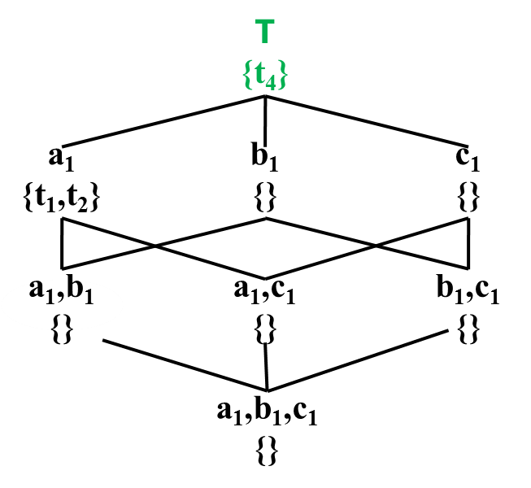
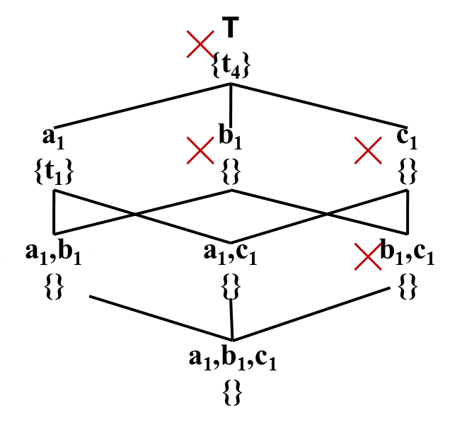
STopDown
id | d₁ | d₂ | d₃ | m₁ | m₂
t₁ | a₁ | b₂ | c₂ | 10 | 15
t₂ | a₁ | b₁ | c₁ | 15 | 10
t₃ | a₂ | b₁ | c₂ | 17 | 17
t₄ | a₂ | b₁ | c₁ | 20 | 20
t₅ | a₁ | b₁ | c₁ | 11 | 15
Comparison with t₄ is skipped
id | d₁ | d₂ | d₃ | m₁ | m₂
t₁ | a₁ | b₂ | c₂ | 10 | 15
t₂ | a₁ | b₁ | c₁ | 15 | 10
t₃ | a₂ | b₁ | c₂ | 17 | 17
t₄ | a₂ | b₁ | c₁ | 20 | 20
t₅ | a₁ | b₁ | c₁ | 11 | 15
©2015 The University of Texas at Arlington. All Rights Reserved.

Slide 120
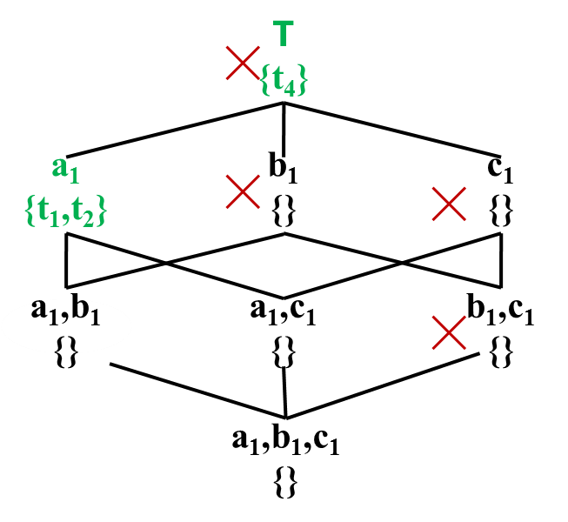
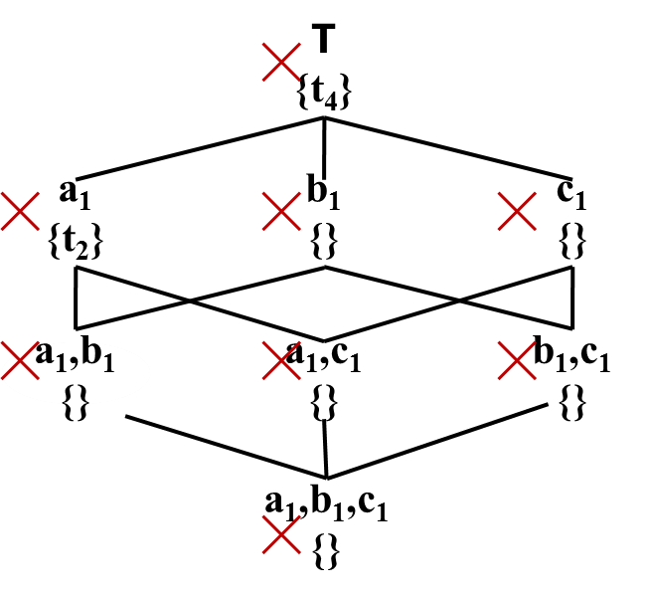
STopDown
id | d₁ | d₂ | d₃ | m₁ | m₂
t₁ | a₁ | b₂ | c₂ | 10 | 15
t₂ | a₁ | b₁ | c₁ | 15 | 10
t₃ | a₂ | b₁ | c₂ | 17 | 17
t₄ | a₂ | b₁ | c₁ | 20 | 20
t₅ | a₁ | b₁ | c₁ | 11 | 15
Comparisons with t₂ & t₄ are skipped
id | d₁ | d₂ | d₃ | m₁ | m₂
t₁ | a₁ | b₂ | c₂ | 10 | 15
t₂ | a₁ | b₁ | c₁ | 15 | 10
t₃ | a₂ | b₁ | c₂ | 17 | 17
t₄ | a₂ | b₁ | c₁ | 20 | 20
t₅ | a₁ | b₁ | c₁ | 11 | 15
©2015 The University of Texas at Arlington. All Rights Reserved.

Slide 121
Experiment Setup
NBA Dataset
317,371 tuples of NBA box scores from 1991-2004 seasons
8 dimension attributes
7 measure attributes
Weather Dataset
7.8 million tuples of weather forecast from different locations of six countries & regions of UK
7 dimension attributes
7 measure attributes
©2015 The University of Texas at Arlington. All Rights Reserved.

Slide 122
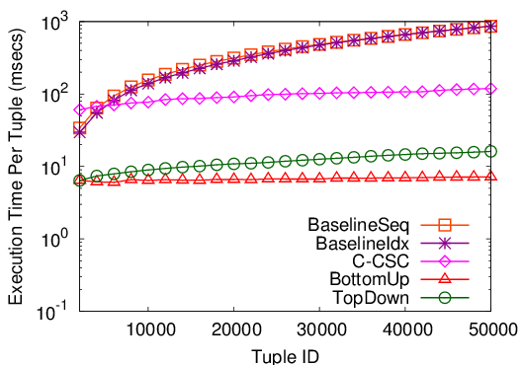
Memory-Based Implementation
NBA Dataset
Maintaining CSC for each constraint causes overhead
(Xia et al. SIGMOD 2006)
Can’t take advantage of constraint pruning
©2015 The University of Texas at Arlington. All Rights Reserved.

Slide 123
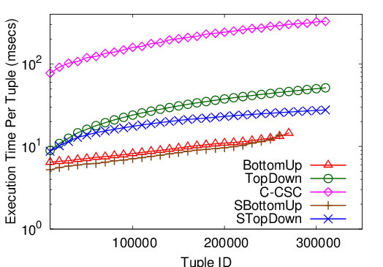
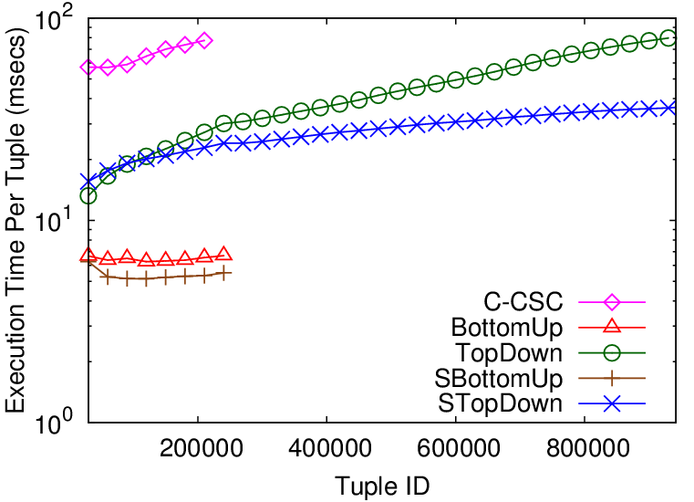
Memory-Based Implementation
NBA Dataset
Weather Dataset
BottomUp/SBottomUp exhausted available JVM heap
memory overflow
TopDown / STopDown was outperformed by BottomUp/ SBottomUp
Updating maximal skyline constraints causes overhead
©2015 The University of Texas at Arlington. All Rights Reserved.

Slide 124
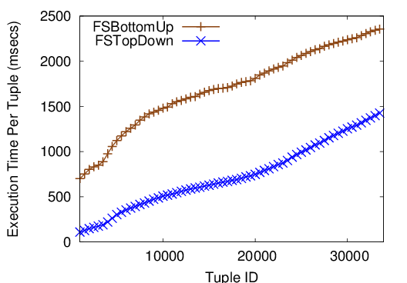
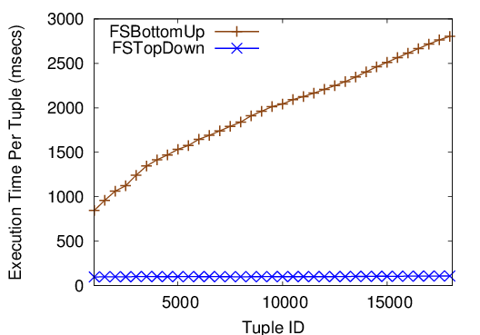
File-Based Implementation
NBA Dataset
Weather Dataset
Each (C,M) is stored in a binary file
While traversing, file-read operation occurs if file is non-empty: FSTopDown encounters many empty files
For updating, file-write operation occurs: FSTopDown stores fewer tuples
I/O-cost dominates in-memory computation
©2015 The University of Texas at Arlington. All Rights Reserved.

Slide 125
Discovered Facts
Lamar Odom had 30 points, 19 rebounds and 11 assists on March 6, 2004. No one before had a better or equal performance in NBA history.
Allen Iverson had 38 points and 16 assists on April 14, 2004 to become the first player with a 38/16 (points/assists) game in the 2004-2005 season.
Damon Stoudamire scored 54 points on January 14, 2005. It is the highest score in history made by any Trail Blazers.
©2015 The University of Texas at Arlington. All Rights Reserved.

Slide 126
Prominent Streak Discovery in Sequence Data. Xiao Jiang, Chengkai Li, Ping Luo, Min Wang, Yong Yu. KDD 2011, pages 1280-1288.
Discovering General Prominent Streaks in Sequence Data. Gensheng Zhang, Xiao Jiang, Ping Luo, Min Wang, Chengkai Li. ACM TKDD, 8(2):article 9, June 2014.
©2015 The University of Texas at Arlington. All Rights Reserved.

Slide 127
Prominent Streaks
Prominent streaks stated in news articles:
“This month the Chinese capital has experienced 10 days with a maximum temperature in around 35 degrees Celsius – the most for the month of July in a decade.”
“The Nikkei 225 closed below 10000 for the 12th consecutive week, the longest such streak since June 2009.”
“He (LeBron James) scored 35 or more points in nine consecutive games and joined Michael Jordan and Kobe Bryant as the only players since 1970 to accomplish the feat.”
©2015 The University of Texas at Arlington. All Rights Reserved.

Slide 128
Concepts
Streak
Input: a sequence of values
Streak <[l, r], v> is a triple: left-end ( l ), right-end ( r ), minimum value in interval [l,r]
3 1 7 7 2 5 4 6 7 3
<[6, 8], 4>
Streak dominance relation
s1=<[l1, r1], v1> dominates s2=<[l2, r2], v2> iff
r1 - l1 > r2 - l2, v1 >= v2 or r1 - l1 >= r2 - l2, v1 >v2
Prominent streaks (PS)
A streak is prominent if it is not dominated by any other streaks.
©2015 The University of Texas at Arlington. All Rights Reserved.

Slide 129
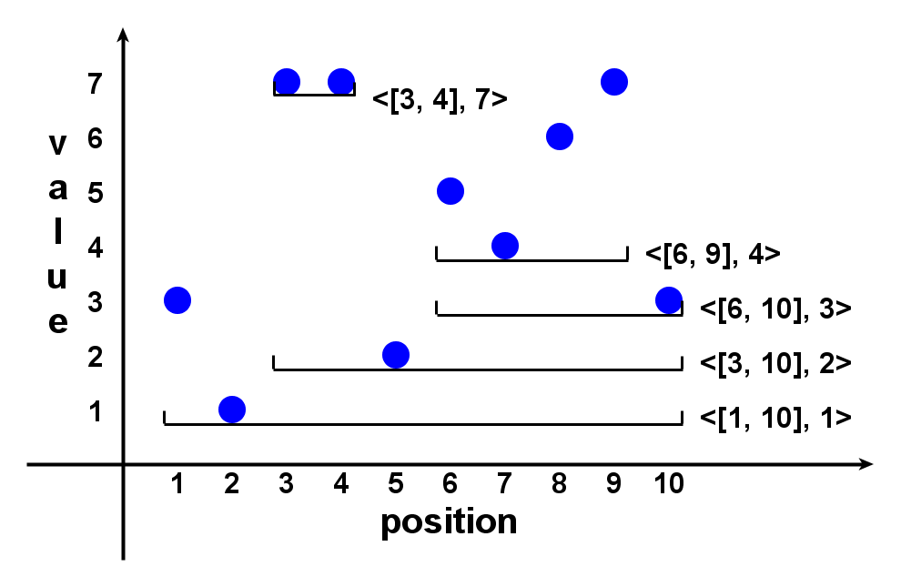
Example
3 1 7 7 2 5 4 6 7 3
©2015 The University of Texas at Arlington. All Rights Reserved.

Slide 130
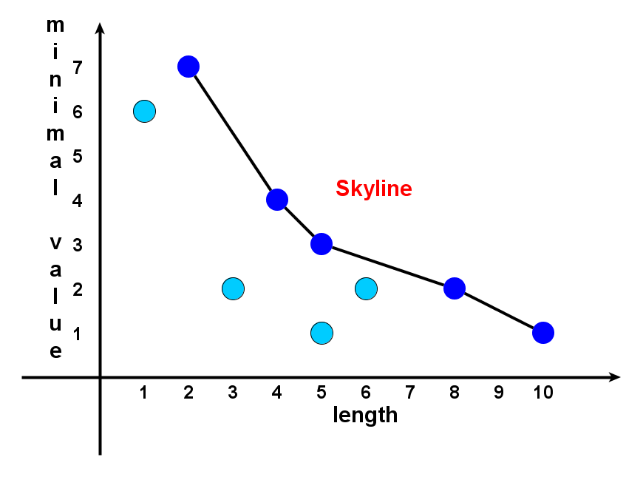
Prominent Streaks are Skyline Points in 2-d Space
3 1 7 7 2 5 4 6 7 3
©2015 The University of Texas at Arlington. All Rights Reserved.

Slide 131
Tasks
Task 1: discovery
Find all prominent streaks in a sequence
Task 2: monitoring
Always keep prominent streaks up-to-date, when sequence grows (real-world sequences often grow)
©2015 The University of Texas at Arlington. All Rights Reserved.

Slide 132
Solution Framework
Data Value Sequence
3 1 7 7 2 5 4 6 7 3
Candidate Generation Algorithms (brute-force, NLPS, LLPS)
Candidate Streaks
Skyline Operation [Börzsönyi et al. 2001]
(many algorithms)
Prominent Streaks
©2015 The University of Texas at Arlington. All Rights Reserved.

Slide 133
Candidate Generation: Number Of Candidates
Brute-force
Quadratic
NLPS
Superlinear
LLPS
Linear
©2015 The University of Texas at Arlington. All Rights Reserved.

Slide 134
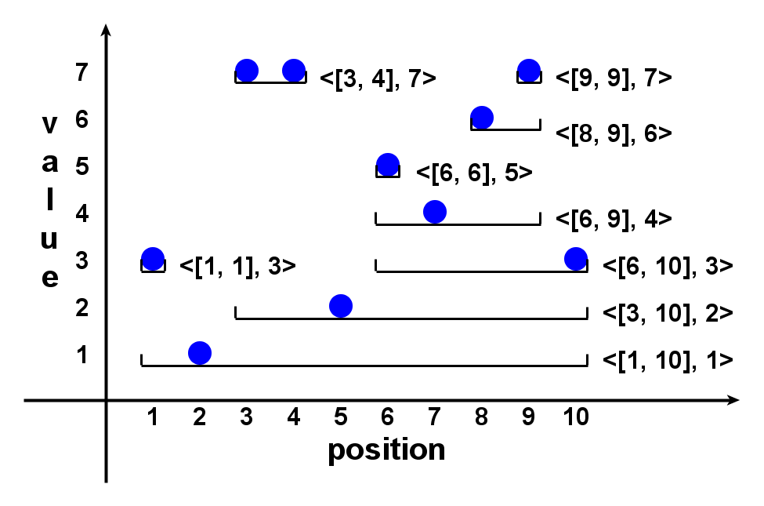
Local Prominent Streak
Local dominance relation
s1=<[l1, r1], v1> locally dominates s2=<[l2, r2], v2> iff
s1 dominates s2 and [l1, r1] ⊃ [l2, r2]
Local prominent streak (LPS)
A streak is locally prominent if it is not locally dominated by any other streaks.
©2015 The University of Texas at Arlington. All Rights Reserved.

Slide 135
Important Properties
(1) LPS is sufficient
A prominent streak must be an LPS.
(2) LPS is small
The number of LPSs is less than or equal to the sequence length.
(Hint: The number of LPSs getting min value at position k is at most 1.)
Conclusion
LPS is an excellent set of candidate streaks, of linear size.
Candidate generation problem => finding local prominent streaks
©2015 The University of Texas at Arlington. All Rights Reserved.

Slide 136
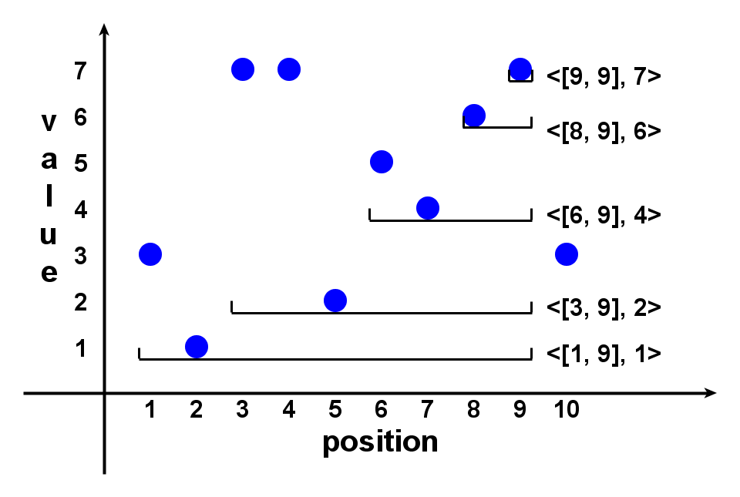

Linear LPS (LLPS) Method
Sequence p₁, p₂, …, p_{n}.
1. Maintain a list of candidate streaks when scanning the sequence rightward.
2. After p_{k} , right-ends of candidates are all k.
3. At p_{k+1} , try to extend the candidates rightward.
Candidates s:
(3.a) s.v < p_{k+1} : extend.
(3.b) s.v > p_{k+1} : belong to LPS.
(3.c) s.v >= p_{k+1} : extend the leftmost (longest) such s.
4. After p_{n} all remaining candidates are LPS.
©2015 The University of Texas at Arlington. All Rights Reserved.

Slide 137


Linear LPS (LLPS) Method
Candidates share the same right-end, their minimum values monotonically increase, if they are listed in the increasing order of left-ends.
©2015 The University of Texas at Arlington. All Rights Reserved.

Slide 138
Linear LPS (LLPS) Method
After p_{k} , it has found:
All LPSs ending before k
Candidates ending at k either are LPSs or can be grown to LPSs ending after k.
Monitoring (keeping prominent streaks up-to-date) is simple:
If PSs till k are requested, compare all found LPSs and all remaining candidates.
©2015 The University of Texas at Arlington. All Rights Reserved.

Slide 139




Datasets In Experiments
©2015 The University of Texas at Arlington. All Rights Reserved.

Slide 140


Sample Prominent Streaks
Melbourne daily min/max temperature between 1981 and 1990 (Melb1 & Melb2)
More than 2000 days with min temperature above zero
6 days: the longest streak above 35 degrees Celsius
Traffic count of Wikipedia page of Lady Gaga (Wiki2)
More than half of the prominent streaks are around Sep. 12th (VMA 2010)
at least 2000 hourly visits lasting for almost 4 days
©2015 The University of Texas at Arlington. All Rights Reserved.

Slide 141
General Prominent Streaks
Top-k, multi-dimensional and multi-sequence PS
“He (LeBron James) scored 35 or more points in nine consecutive games and joined Michael Jordan and Kobe Bryant as the only players since 1970 to accomplish the feat.”
“Only player in NBA history to average at least 20 points, 10 rebounds and 5 assists
per game for 6 consecutive seasons.” (http://en.wikipedia.org/wiki/Kevin Garnett)
NLPS/LLPS extended to such general PSs
©2015 The University of Texas at Arlington. All Rights Reserved.

Slide 142


Experiments On Multi-Sequence PSs
©2015 The University of Texas at Arlington. All Rights Reserved.

Slide 143



Experiments On Multi-Dim PSs
©2015 The University of Texas at Arlington. All Rights Reserved.

Slide 144



Experiments On General PSs
©2015 The University of Texas at Arlington. All Rights Reserved.

Slide 145
Acknowledgment
UTA Students
Naeemul Hassan
Afroza Sultana
Gensheng Zhang
Joseph Minumol
Fatma Dogan
Collaborators
Bill Adair
Pankaj Agarwal
James Hamilton
Ping Luo
Mark Tremayne
Min Wang
Jun Yang
Cong Yu
©2015 The University of Texas at Arlington. All Rights Reserved.

Slide 146




Acknowledgment
Funding sponsors
Disclaimer: This material is based upon work partially supported by the National Science Foundation Grants 1018865, 1117369 and 1408928, 2011 and 2012 HP Labs Innovation Research Awards, and the National Natural Science Foundation of China Grant 61370019. Any opinions, findings, and conclusions or recommendations expressed in this material are those of the author(s) and do not necessarily reflect the views of the funding agencies.
©2015 The University of Texas at Arlington. All Rights Reserved.

Slide 147
Thank You! Questions?
http://ranger.uta.edu/~cli http://idir.uta.edu
cli@uta.edu
Demos
ClaimBuster idir.uta.edu/claimbuster
FactWatcher idir.uta.edu/factwatcher
Please help us label the data
http://bit.ly/claimbusters
©2015 The University of Texas at Arlington. All Rights Reserved.

